Slide 1
Topseller Quick Reference Guide
U.S. | March 2024

Slide 2
Lenovo Topseller - Notebooks

Slide 3
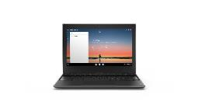
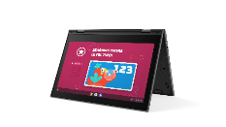
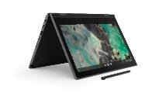
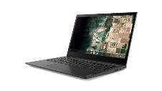
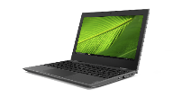




LENOVO TOPSELLERS - EDUCATION
100e Chromebook
300e Chromebook
500e Chromebook
14e Chromebook
100e Windows
300e Windows
14w Windows
ThinkPad 11e G5
ThinkPad 11e Yoga G6

Slide 4
Education Solutions - Chromebooks
100e Chromebook | $221 | $221 | $257
 | 82UY0000US (JSL) | 82W00001US (MTK4) | 83G80000US (IAN)
 | Intel Celeron N4500 | MTK MT8183 | Intel N100
 | 4GB (soldered) | 4GB (soldered) | 4GB (soldered)
 | 32GB eMMC (soldered) | 32GB eMMC (soldered) | 32GB eMMC (soldered)
 | 11.6” HD TN AG | 11.6” HD TN AG | 11.6” HD TN AG Touch
 | 720p HD Camera, 2x2 AC WLAN, BT | Front 720p HD Camera, 2x2 AC WLAN, BT | Front 720p HD Camera, 2x2 AC WLAN, BT
 | 47whr Battery | 47whr Battery | 47whr Battery
 | Chrome OS | Chrome OS | Chrome OS
 | 1 Year Mail-in | 1 Year Mail-in | 1 Year Mail-in
300e Chromebook | $270 | $299
 | 82W20003US (MTK4) | 82W20002US (MTK4)
 | MediaTek MT8186 | MediaTek MT8186
 | 4GB (soldered) | 4GB (soldered)
 | 32GB eMMC (soldered) | 32GB eMMC (soldered)
 | 11.6” HD IPS Touch | 11.6” HD IPS Touch
 | 720p HD camera w/ PS, 2x2 AC WLAN, BT | Front HD 720p camera + Rear 5.0MP, 2x2 AC WLAN, BT
 | 47Whr Battery | 47Whr Battery
 | Chrome OS | Chrome OS
 | 1 Year Mail-in | 1 Year Mail-in
Flex 5i Chromebook | $675
 | 83AJ0000UX
 | Intel® Core™ i5-1235U
 | 8GB (soldered)
 | 256GB PCIe m.2 SSD
 | 14" WUXGA (1920x1200) IPS 300nits Glossy, 45% NTSC, Touch
 | FHD 1080p wi/ Privacy Shutter, 2x2 AX WLAN, BT, Aluminum, Backlit Keyboard
 | 51Whr Battery
 | Chrome OS
 | 1 Year Mail-in
500e Chromebook G2 | $299 | $295 | $344 | $368
 | 82JB0001US (JSL) | 82JB003XUS (JSL) | 82W40009US (IAN) | 82W4000AUS IAN
 | Intel Celeron N5100 | Intel Celeron N4500 | Intel N100 | Intel N100
 | 4GB (soldered) | 4GB (soldered) | 4GB (soldered) | 4GB (soldered)
 | 32GB eMMC (soldered) | 32GB eMMC (soldered) | 32GB eMMC (soldered) | 32GB eMMC (soldered)
 | 11.6” HD IPS Touch | 11.6” HD IPS Touch | 12.2" WUXGA Touch | 12.2" WUXGA Touch
 | World Facing Camera, pen, 2x2 AC WLAN, BT | Front HD 720p with Privacy Shutter | Front HD 720p with Privacy Shutter | Front HD 720p with Privacy Front HD 720p with Privacy Shutter + Rear 5.0MPShutter + Pen
 | 42Whr Battery | 42Whr Battery | 47Whr Battery | 47Whr Battery
 | Chrome OS | Chrome OS | Chrome OS | Chrome OS
 | 1 Year Mail-in | 1 Year Mail-in | 1 Year Mail-in | 1 Year Mail-in
14e Chromebook
$294 | $385
82W60000US (IAN) | 82W6000AUS (IAN)
Intel N100 | Intel N100
4GB (soldered) | 4GB (soldered)
32GB eMMC (soldered) | 32GB eMMC (soldered)
14" HD Non-Touch | 14" FHD Touch
HD 720p with Privacy Shutter | HD 720p with Privacy Shutter
57Whr Battery | 57Whr Battery
Chrome OS | Chrome OS
1 Year Mail-in | 1 Year Mail-in

Slide 5
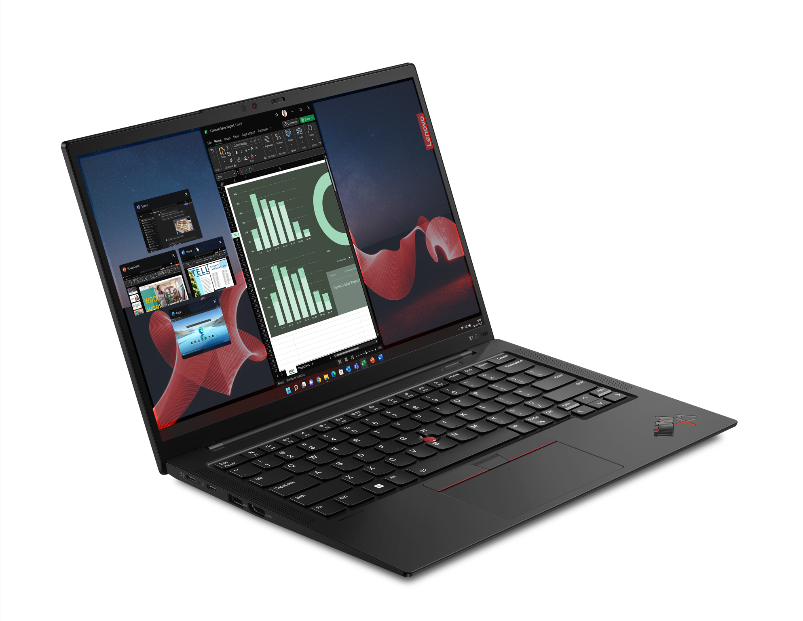
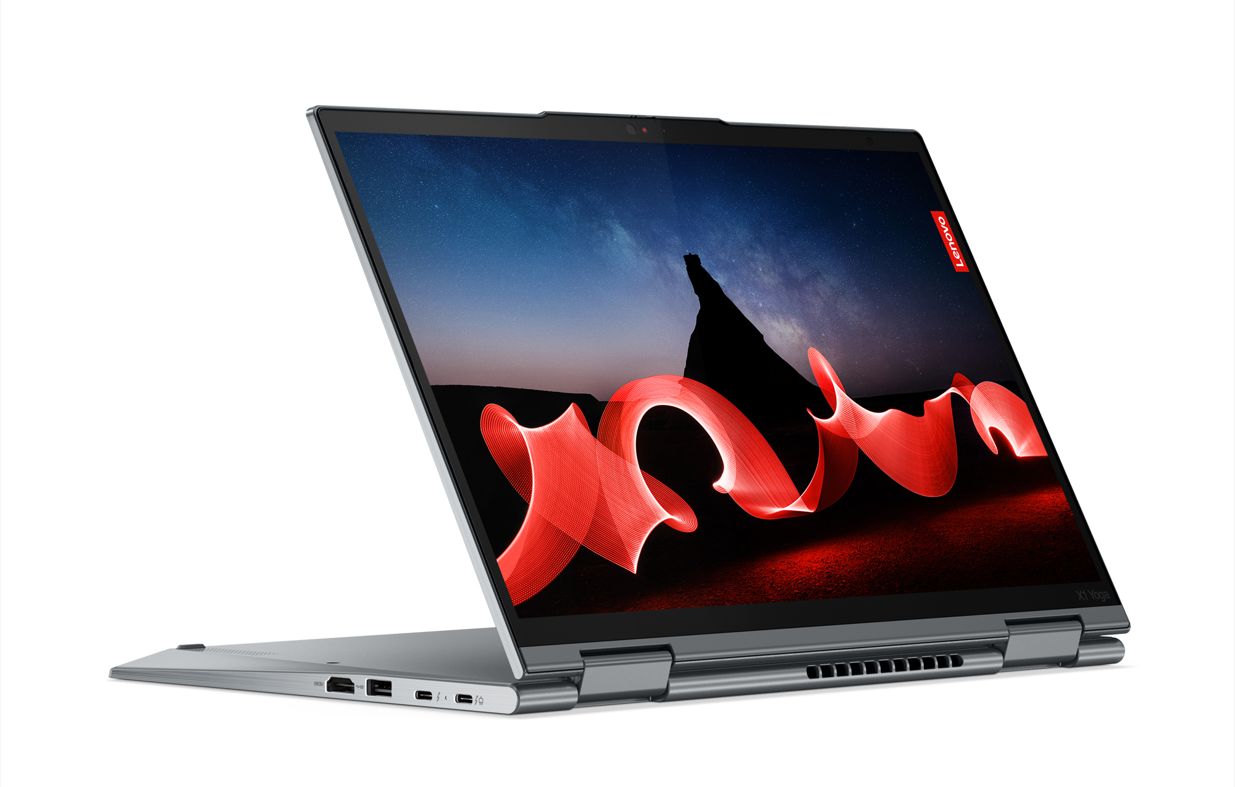
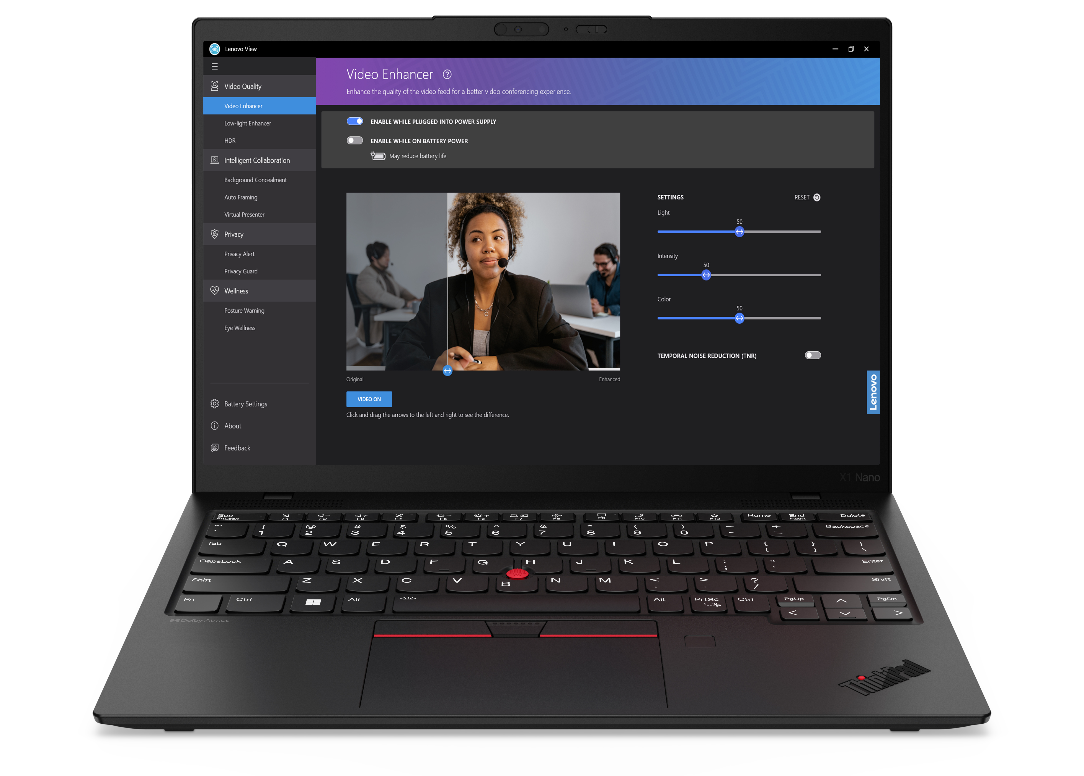
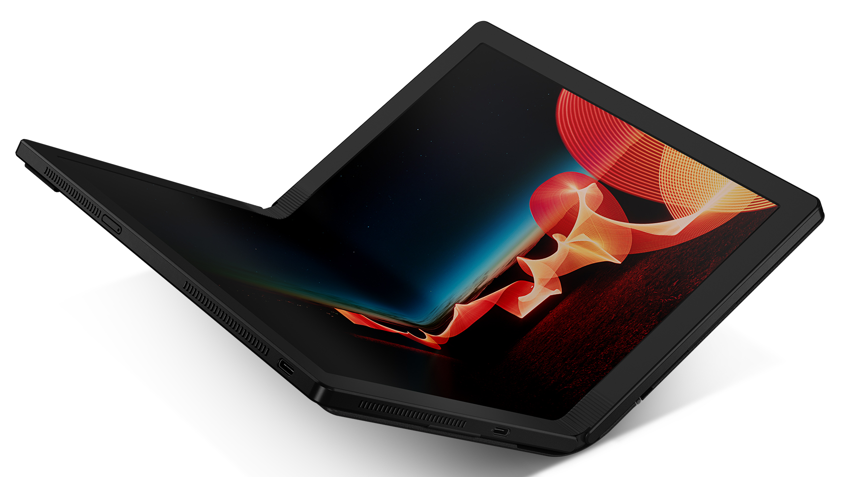
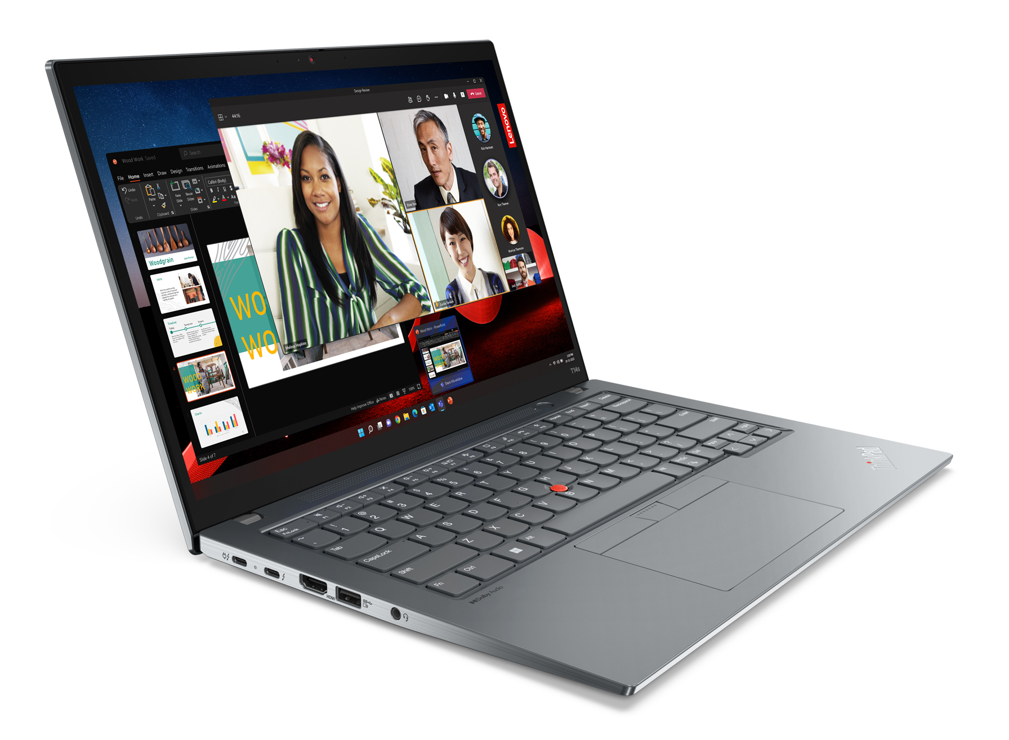
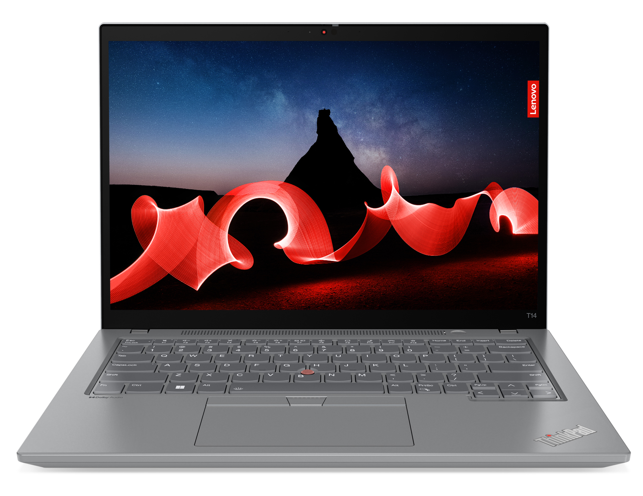
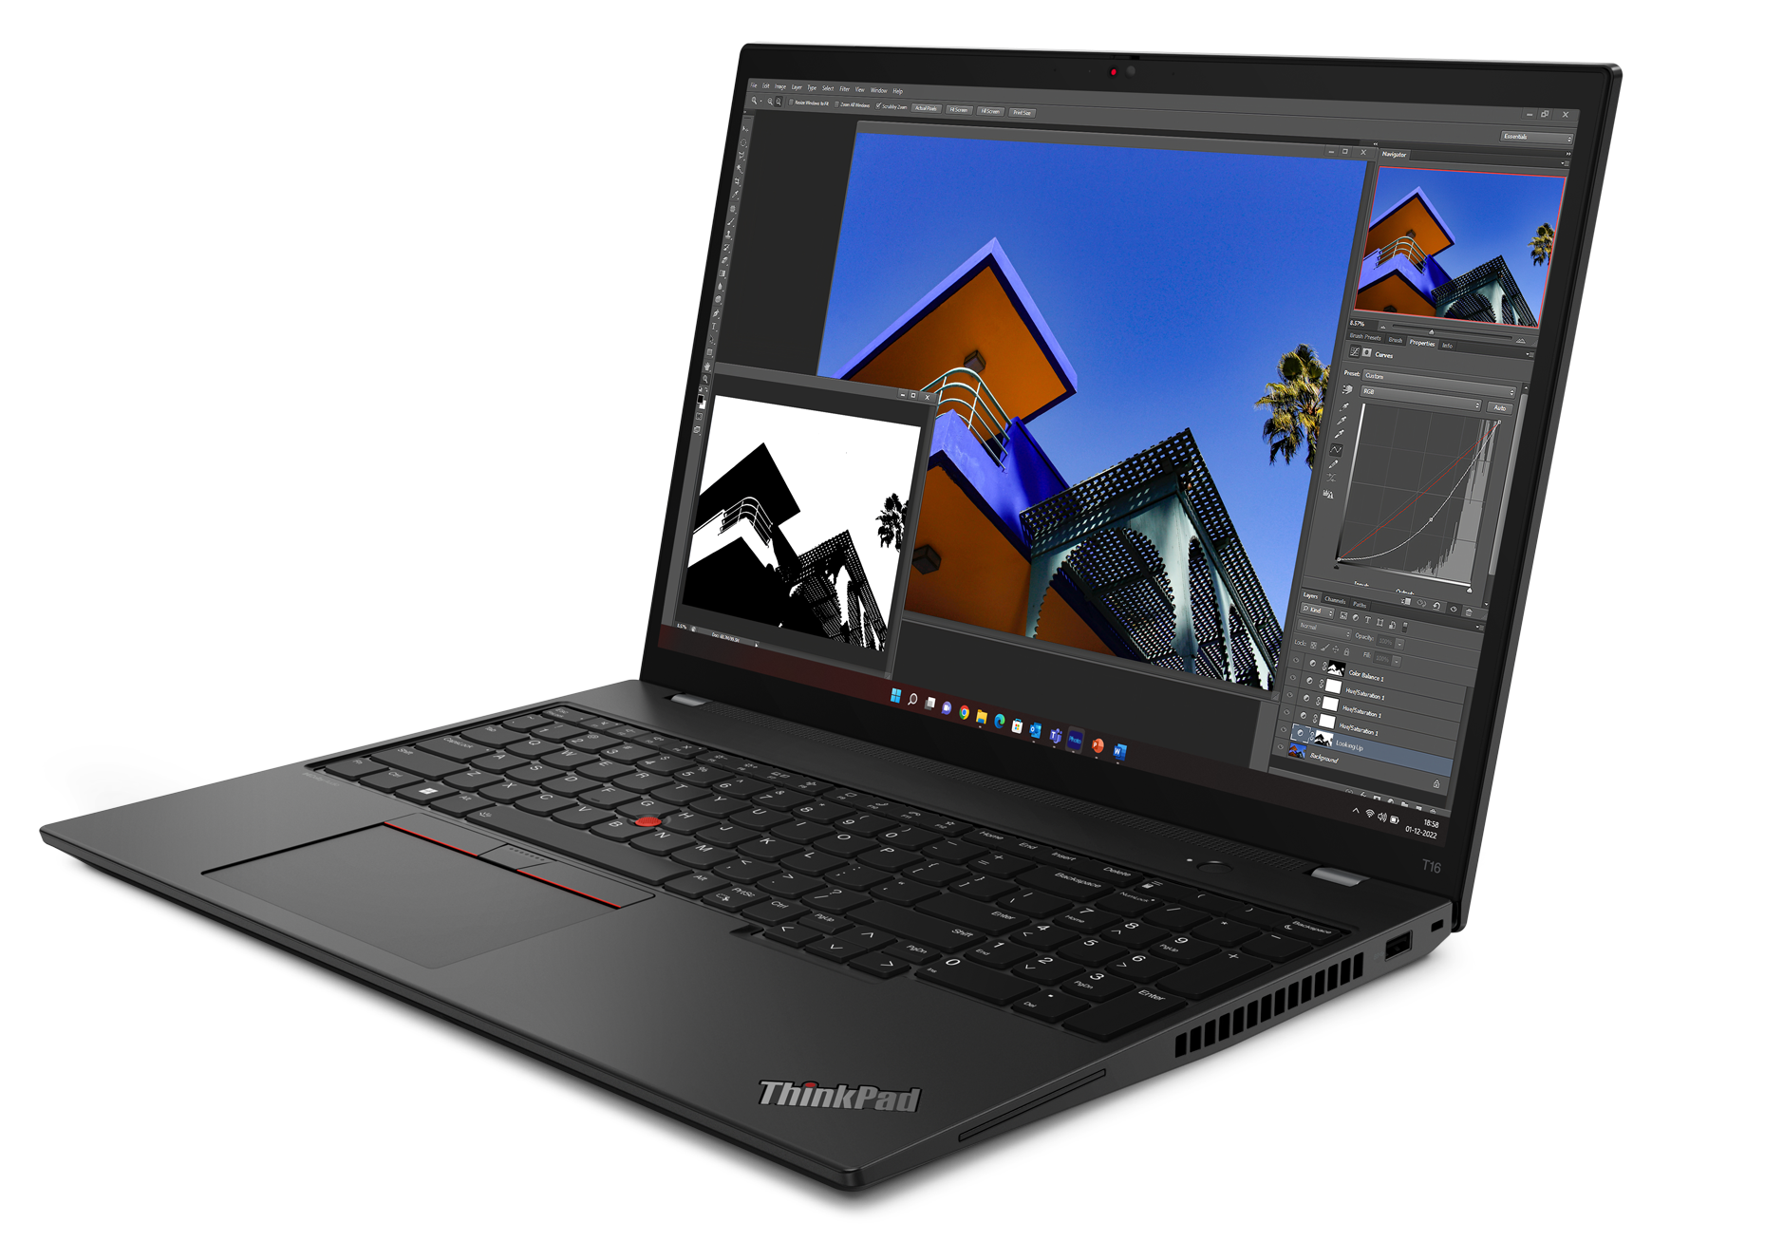
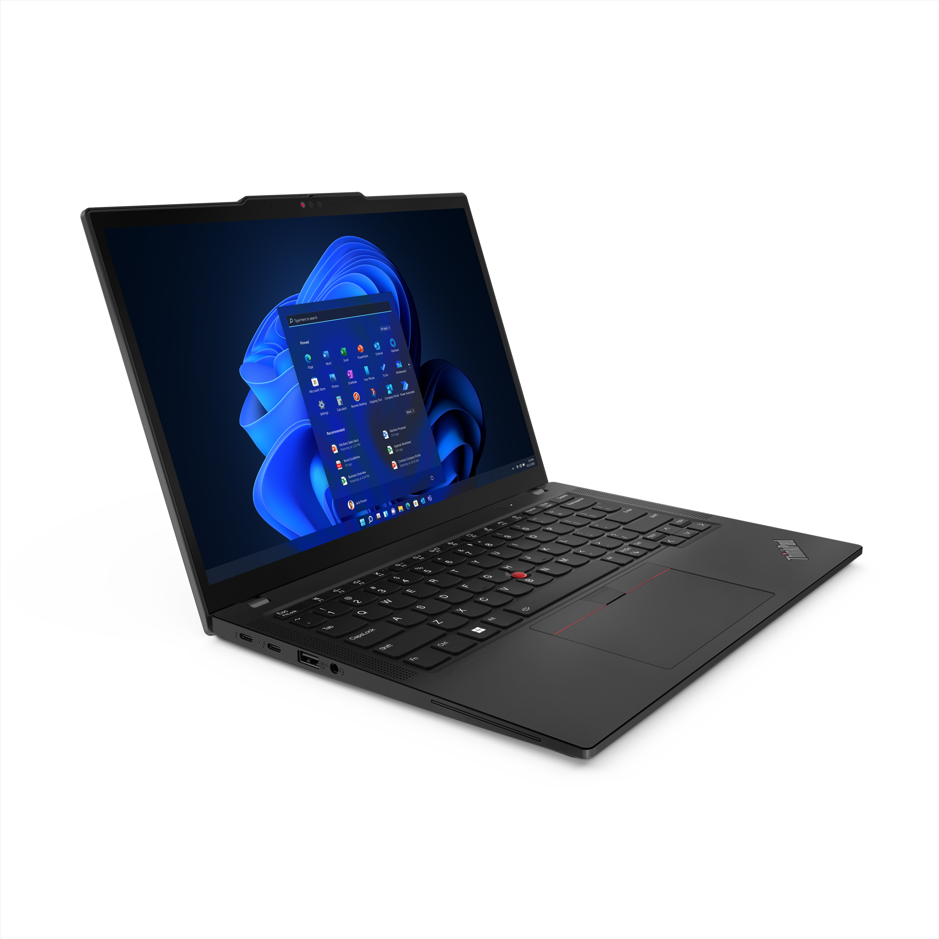
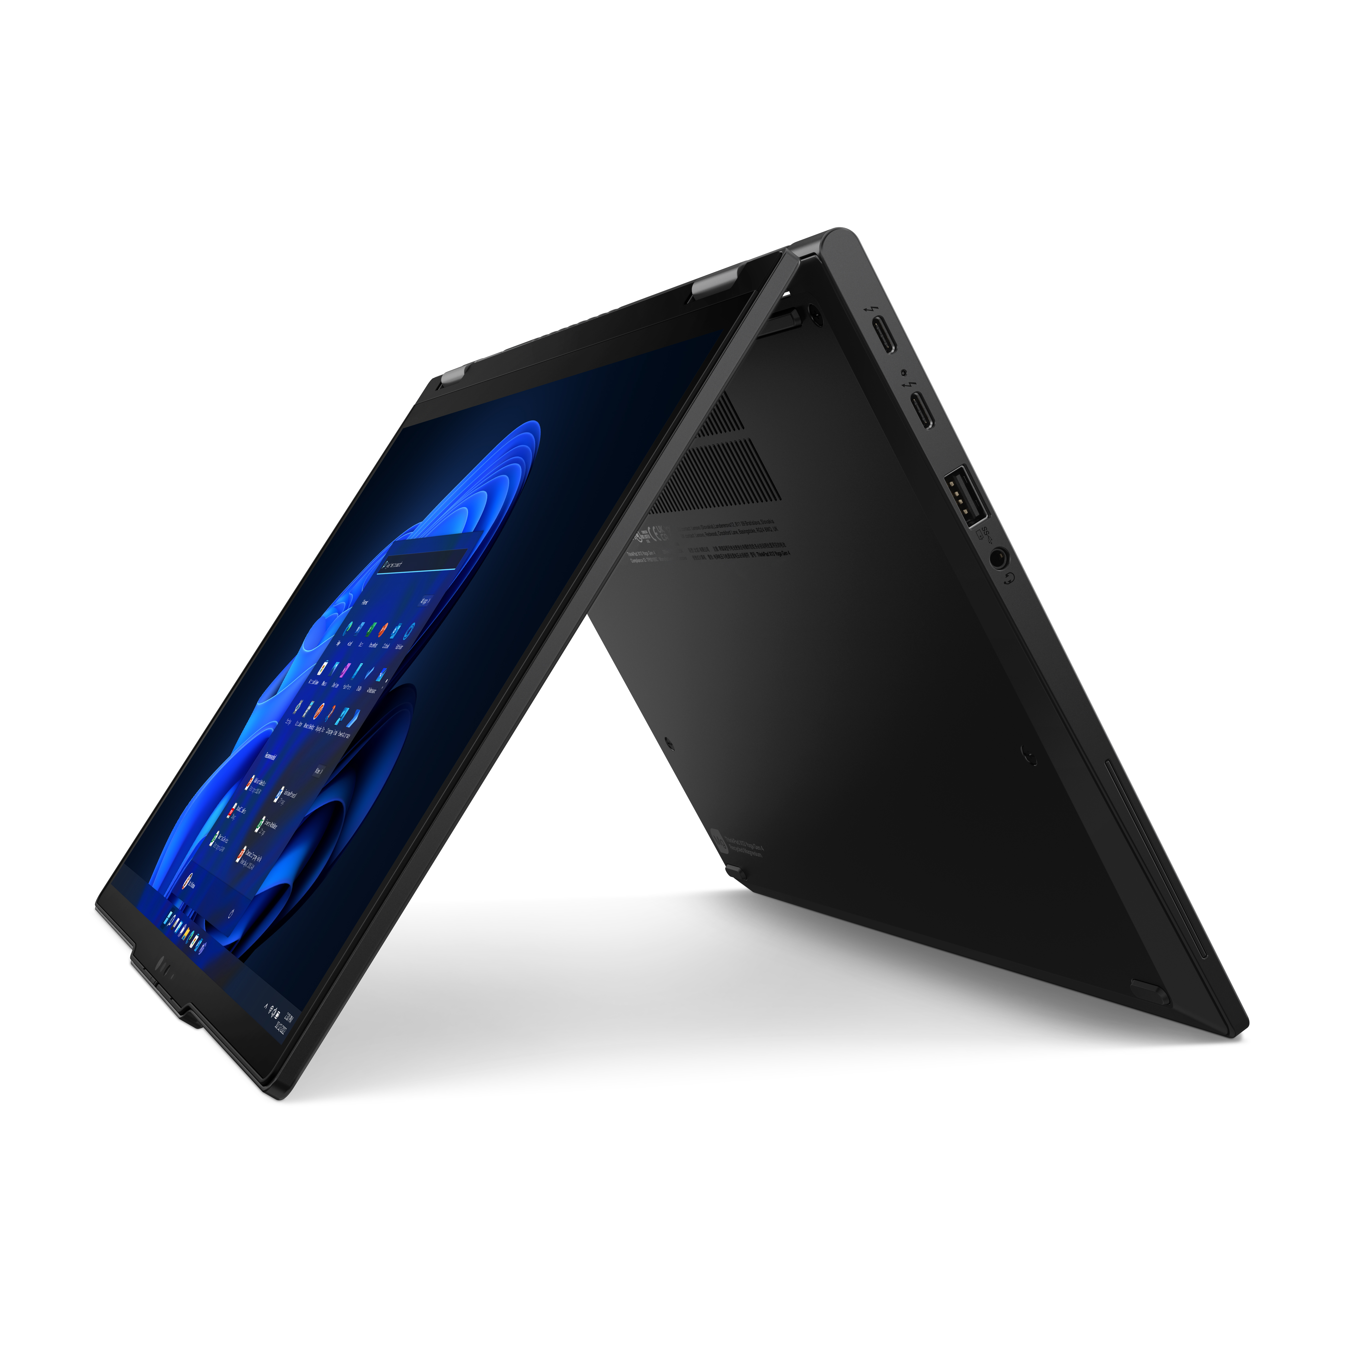
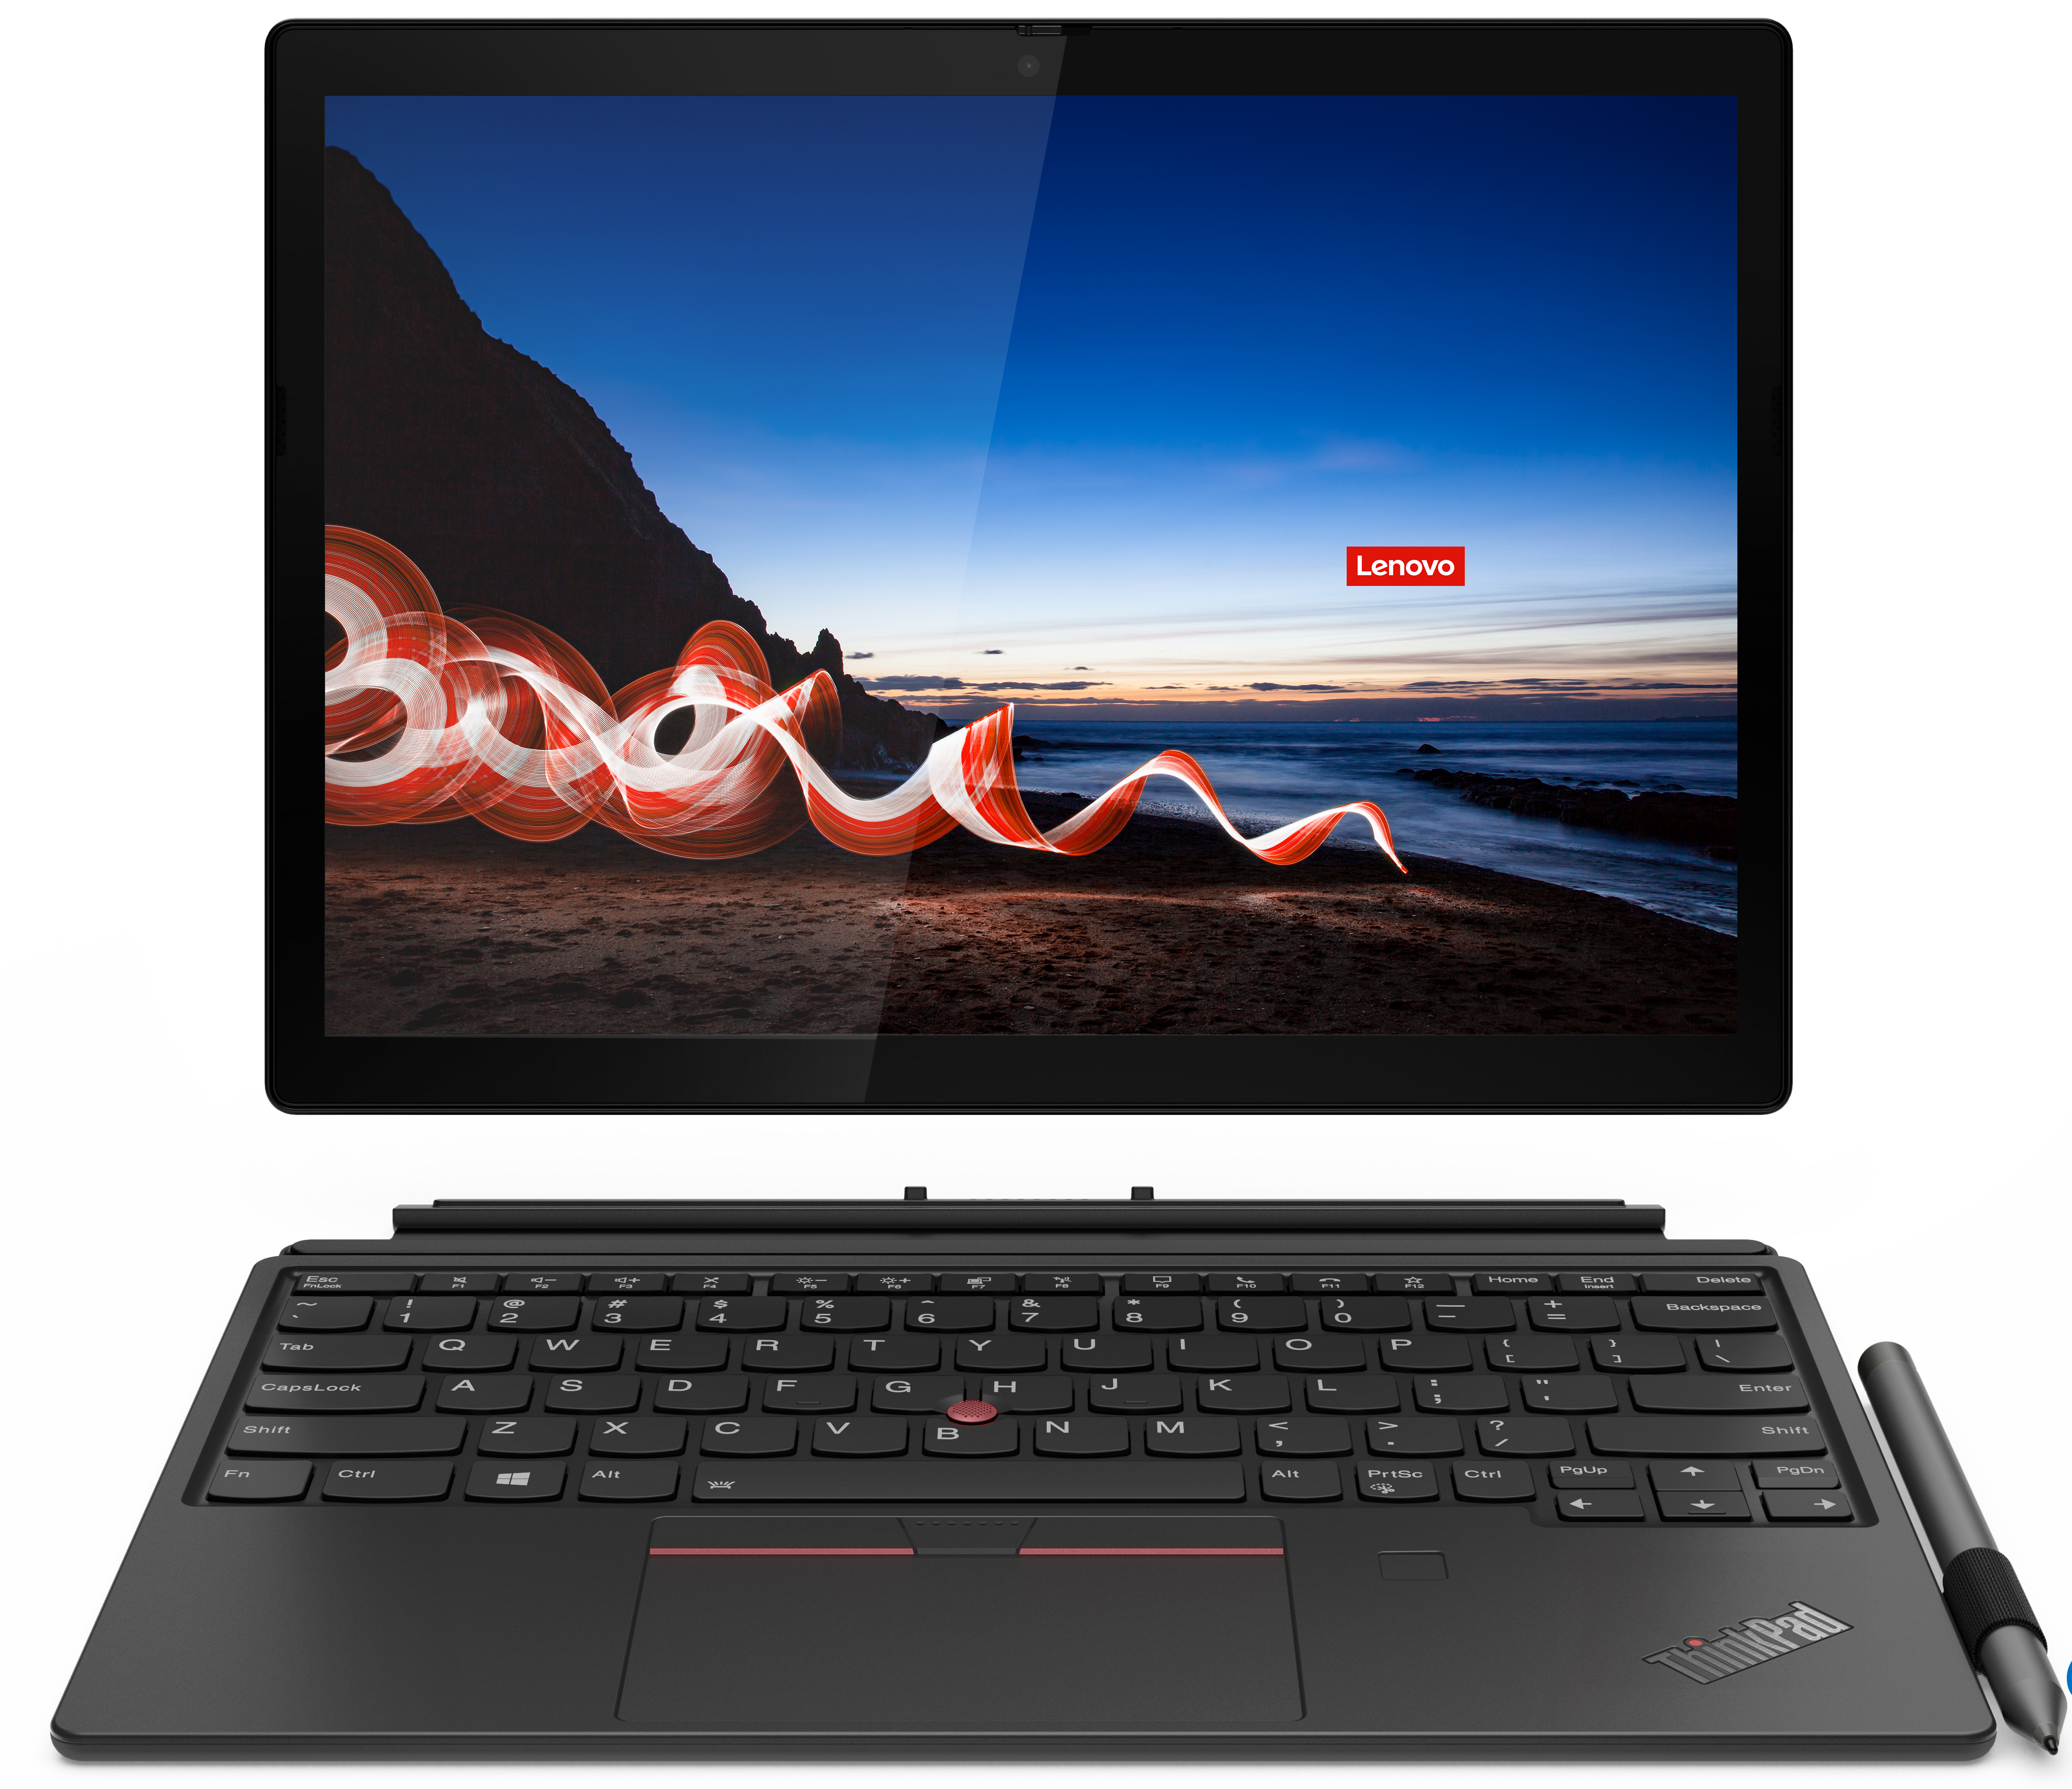
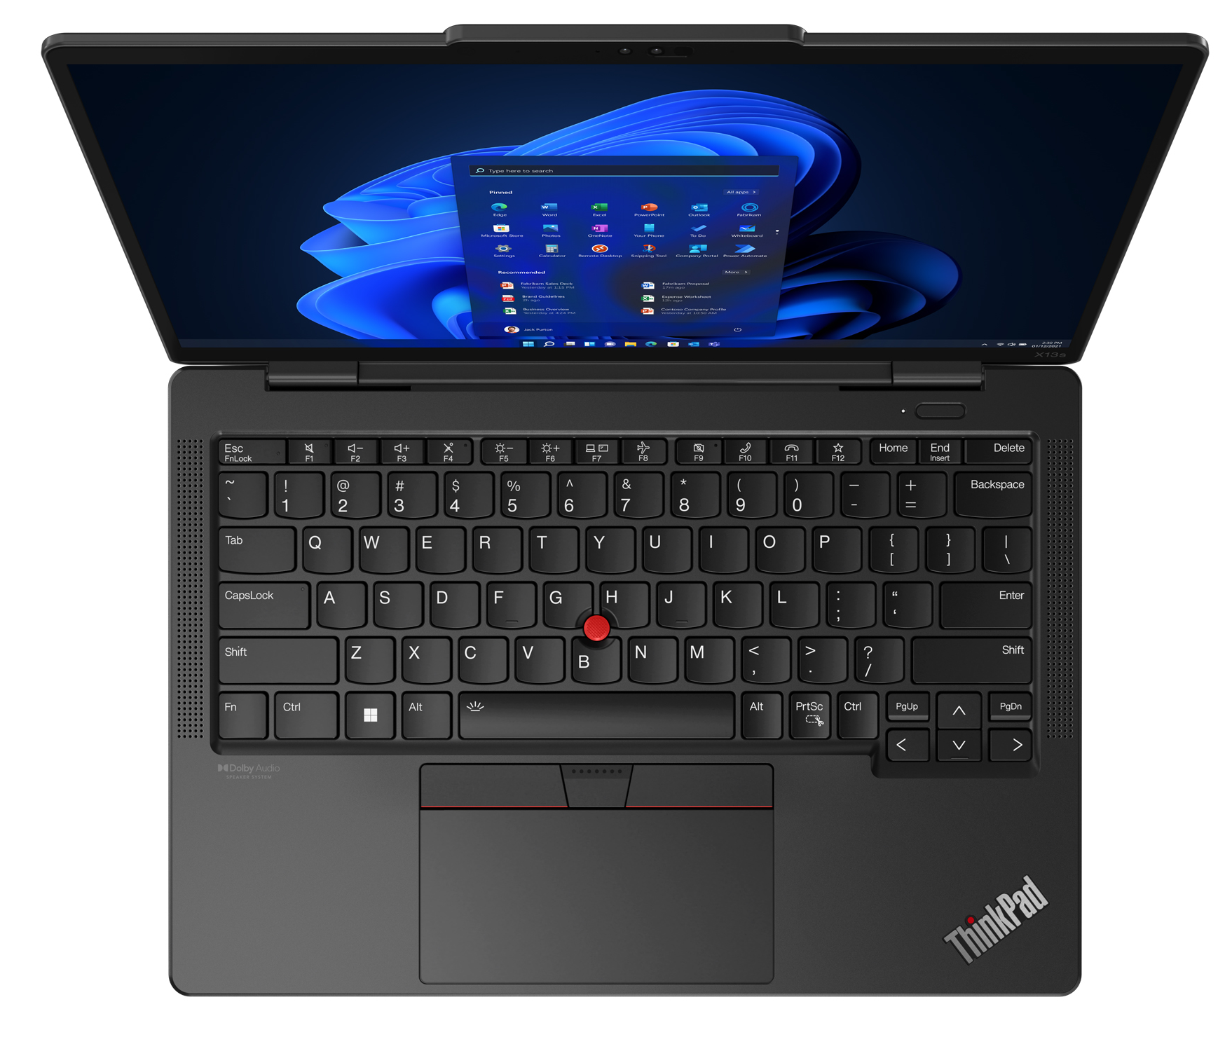
Premium ThinkPad
X1 Carbon 11th Gen
X1 Yoga 8th Gen
X1 Nano Gen 3
X1 Fold 16
T14s G4 (Intel/AMD)
T14 G4 (Intel/AMD)
T16 G2 (Intel/AMD)
X12 Detachable G1
X13 Yoga G3
X13s Gen 1
X13 G3 (Intel/AMD)

Slide 6
Premium ThinkPad T and X Series
T14 G4 (Intel) | $1443 | $1517 | $1599 | $1645 | $1747
 | Rebate: $100
 | 21HD0086US | 21HD0028US - Grey | 21HD0087US | 21HD002BUS - Grey | 21HD0088US
 | Core i5-1345U Vpro | Core i5-1335U | Core i5-1345U Vpro | Core i7-1355U | Core i7-1365U Vpro
 | 16GB | 16GB | 16GB | 16GB | 16GB
 | 256GB PCIe SSD | 512GB PCIe SSD | 512GB PCIe SSD | 512GB PCIe SSD | 512GB PCIe SSD
 | 14” FHD | 14" FHD Touch + IR Cam | 14" FHD Touch + IR Cam | 14" FHD Touch + IR Cam | 14" FHD Touch + IR Cam
 | Camera, Backlit Keyboard, FPR, 2x2 + BT5.2, BT | Camera, Backlit Keyboard, FPR, 2x2 + BT5.2, BT | Camera, Backlit Keyboard, FPR, 2x2 + BT5.2, BT | Camera, Backlit Keyboard, FPR, 2x2 + BT5.2, BT | Camera, Backlit Keyboard, FPR, 2x2 + BT5.2, BT
 | Integrated 39Wh | Integrated 39Wh | Integrated 39Wh | Integrated 39Wh | Integrated 39Wh
 | Windows 11 Pro | Windows 11 Pro | Windows 11 Pro | Windows 11 Pro | Windows 11 Pro
 | 3 Year Depot | 3 Year Depot | 3 Year Depot | 3 Year Depot | 3 Year Depot
T14s G4 (Intel) | $1471 | $1710 | $1875
 |  | Rebate: $100
 | 21F6001CUS - Grey | 21F6001BUS - Grey | 21F6001HUS - Grey
 | Core i5-1335U | Core i7-1355U | Core i7-1365U Vpro
 | 16GB (soldered) | 16GB (soldered) | 16GB (soldered)
 | 256GB PCIe SSD | 512GB PCIe SSD | 512GB PCIe SSD
 | 14” FHD | 14” FHD | 14” FHD Touch
 | Camera, Backlit Keyboard, FPR, 2x2 AX WLAN, BT | Camera, Backlit Keyboard, FPR, 2x2 AX WLAN, BT | Camera, Backlit Keyboard, FPR, 2x2 AX WLAN, BT
 | Integrated 57Wh | Integrated 57Wh | Integrated 57Wh
 | Windows 11 Pro | Windows 11 Pro | Windows 11 Pro
 | 3 Year Depot | 3 Year Depot | 3 Year Depot
T16 G2 (Intel) | $1379 | $1535 | $1655 | $1765
 |  | Rebate: $100
 | 21HH001FUS | 21HH001JUS | 21HH001MUS - Grey | 21HH0053US
 | Core i5-1335U | Core i5-1335U | Core i7-1355U | Core i7-1365U Vpro
 | 16GB | 16GB | 16GB | 16GB
 | 256GB PCIe SSD | 512GB PCIe SSD | 512GB PCIe SSD | 512GB PCIe SSD
 | 16” FHD | 16" FHD + IR Cam | 16’ FHD + IR Cam | 16" FHD Touch + IR Cam
 | Camera, Backlit Keyboard, FPR, 2x2 AX WLAN, BT | Camera, Backlit Keyboard, FPR, 2x2 AX WLAN, BT | Camera, Backlit Keyboard, FPR, 2x2 AX WLAN, BT | Camera, Backlit Keyboard, FPR, 2x2 AX WLAN, BT
 | Integrated 52Wh | Integrated 52Wh | Integrated 52Wh | Integrated 52Wh
 | Windows 11 Pro | Windows 11 Pro | Windows 11 Pro | Windows 11 Pro
 | 3 Year Depot | 3 Year Depot | 3 Year Depot | 3 Year Depot
X13 G4 (Intel) | $1443 | $1526
 | Rebate: $100
 | 21EX0008US - Grey | 21EX0006US
 | Core i7-1355U | Core i7-1365U Vpro
 | 16GB (soldered) | 16GB (soldered)
 | 512GB PCIe SSD | 512GB PCIe SSD
 | 13.3” FHD+ Touch + IR Cam | 13.3” FHD+ Touch
 | Camera, Backlit Keyboard, FPR, 2x2 AX WLAN, BT | Camera, Backlit Keyboard, FPR, 2x2 AX WLAN, BT
 | Integrated 41Wh | Integrated 41Wh
 | Windows 11 Pro | Windows 11 Pro
 | 3 Year Depot | 3 Year Depot
X13 Yoga G4 (Intel) | $1360 | $1609 | $1710
 | 21F2000HUS - Grey | 21F2000KUS - Grey | 21F2000LUS - Grey
 | Core i5-1335U | Core i7-1355U | Core i7-1365U Vpro
 | 16GB | 16GB | 16GB
 | 256GB PCIe SSD | 512GB PCIe SSD | 512GB PCIe SSD
 | 14” FHD Touch | 14” FHD Touch | 14” FHD Touch
 | Camera, Backlit Keyboard, FPR, 2x2 AX WLAN, BT | Camera, Backlit Keyboard, FPR, 2x2 AX WLAN, BT | Camera, Backlit Keyboard, FPR, 2x2 AX WLAN, BT
 | 4 Cell 57Wh Battery | 4 Cell 57Wh Battery | 4 Cell 57Wh Battery
 | Windows 11 Pro | Windows 11 Pro | Windows 11 Pro
 | 3 Year Depot | 3 Year Depot | 3 Year Depot
X13s (Qualcomm) | $1,333 | $1,453
 | Rebate: $400 | Rebate: $400
 | 21BX0013US | 21BX0014US
 | SC8280XP | SC8280XP
 | 16GB (soldered) | 16GB (soldered)
 | 256GB PCIe SSD | 256GB PCIe SSD
 | 13.3” FHD+ Touch + IR Cam | 13.3” QHD+ Touch + IR Cam + WWAN 5G
 | Camera, Backlit KBD, FPR, 2x2 AX WLAN, BT, Pen | IR Camera, Backlit KBD, FPR, 2x2 AX WLAN, BT, Pen
 | 4Cell 49.5Whr Battery | 4Cell 49.5Whr Battery
 | Win 11 Pro ARM | Win 11 Pro ARM
 | 3 Year Premier Support | 3 Year Premier Support

Slide 7
Premium ThinkPad X1 Series
X1 Carbon 11th Gen | $1581 | $1903 | $2142
 | Rebate: $100 |  | Rebate: $100
 | 21HM000GUS | 21HM000JUS | 21HM000SUS
 | Core i5-1335U | Core i7-1355U | Core i7-1365U Vpro
 | 16GB (soldered) | 16GB (soldered) | 32GB (soldered)
 | 256GB PCIe SSD | 512GB PCIe SSD | 512GB PCIe SSD
 | 14” FHD (400nit) | 14” FHD (400nit) + Touch + IR Cam | 14” FHD (400nit) + Touch + IR Cam
 | Camera, Backlit KBD, FPR, 2x2 AX WLAN, BT | Camera, Backlit KBD, FPR, 2x2 AX WLAN, BT | Camera, Backlit KBD, FPR, 2x2 AX WLAN, BT
 | Integrated 57Wh | Integrated 57Wh | Integrated 57Wh
 | Windows 11 Pro | Windows 11 Pro | Windows 11 Pro
 | 3 Year Premier Support, LSA | 3 Year Premier Support, LSA | 3 Year Premier Support, LSA
X1 Yoga 8th Gen | $1719 | $2004 | $2105 | $2253
 | Rebate: $100 | Rebate: $100
 | 21HQ001NUS - Grey | 21HQ0007US – Grey | 21HQ000BUS - Grey | 21HQ000CUS - Grey
 | Core i5-1335U | Core i7-1355U | Core i7-1365U Vpro | Core i7-1365U Vpro
 | 16GB (soldered) | 16GB (soldered) | 16GB (soldered) | 16GB (soldered)
 | 256GB PCIe SSD | 512GB PCIe SSD | 512GB PCIe SSD | 512GB PCIe SSD
 | 14” FHD+ Touch | 14" FHD + Touch + IR Cam | 14" FHD + Touch + IR Cam | 14” FHD+ Touch + IR Cam + WWAN
 | Camera, Backlit KBD, FPR, 2x2 AX WLAN, BT, Pen | Camera, Backlit KBD, FPR, 2x2 AX WLAN, BT, Pen | Camera, Backlit KBD, FPR, 2x2 AX WLAN, BT, Pen | Camera, Backlit KBD, FPR, 2x2 AX WLAN, BT, Pen
 | Integrated 57Wh | Integrated 57Wh | Integrated 57Wh | Integrated 57Wh
 | Windows 11 Pro | Windows 11 Pro | Windows 11 Pro | Windows 11 Pro
 | 3 Year Premier Support, LSA | 3 Year Premier Support, LSA | 3 Year Premier Support, LSA | 3 Year Premier Support, LSA
X1 Nano G3 | $1563
 | 21K10009US
 | Core i7-1360P
 | 16GB (soldered)
 | 512GB PCIe SSD
 | 13” 2K Display + Touch + IR Cam
 | Camera, Backlit KBD, FPR, 2x2 AX WLAN, BT
 | Integrated 50Wh
 | Windows 11 Pro
 | 3 Year Premier Support

Slide 8


Premium ThinkPad AMD Series
T14 G3 (AMD) | $919 | $1682 | $999
 |  | Rebate: $500
 | 21CF005TUS | 21CF000EUS - Grey | 21CF003TUS
 | Ryzen 5 PRO 6650U | Ryzen 7 PRO 6850U | Ryzen 7 PRO 6850U
 | 16GB | 16GB | 16GB
 | 256GB PCIe SSD | 512GB PCIe SSD | 512GB PCIe SSD
 | 14" FHD + Touch + Cam | 14" FHD + Touch + IR Cam | 14" FHD + Touch + IR Cam
 | Camera, Backlit Keyboard, FPR, Wi-Fi 6E, 11ax, 2x2 + BT5.2 | Camera, Backlit Keyboard, FPR, Wi-Fi 6E, 11ax, 2x2 + BT5.2 | Camera, Backlit Keyboard, FPR, Wi-Fi 6E, 11ax, 2x2 + BT5.2
 | Integrated 52Wh | Integrated 52Wh | Integrated 52Wh
 | Windows 11 Pro | Windows 11 Pro | Windows 11 Pro
 | 3 Year Depot | 3 Year Depot | 3 Year Depot
T14 G4 (AMD) | $1011 | $1094 | $1177
 | 21K30004US | 21K30005US | 21K30006US
 | Ryzen 5 PRO 7540U | Ryzen 5 PRO 7540U | Ryzen 7 PRO 7840U
 | 16GB | 16GB | 16GB
 | 256GB PCIe SSD | 512GB PCIe SSD | 512GB PCIe SSD
 | 14" HD + Cam | 14" FHD + Touch + IR Cam | 14" FHD + Touch + 5MP IR Cam
 | Camera, Backlit Keyboard, FPR, Wi-Fi 6E, 11ax, 2x2 + BT5.2 | IR Camera, Backlit Keyboard, FPR, Wi-Fi 6E, 11ax, 2x2 + BT5.2 | 5MP IR Camera, BL Keyboard, FPR, Wi-Fi 6E, 11ax, 2x2 + BT5.2
 | Integrated 39Wh | Integrated 39Wh | Integrated 39Wh
 | Windows 11 Pro | Windows 11 Pro | Windows 11 Pro
 | 3 Year Depot | 3 Year Depot | 3 Year Depot
T14S G4 (AMD) | $1085 | $1158 | $1259
 | 21F8004KUS | 21F80049US | 21F8004AUS
 | Ryzen 5 PRO 7540U | Ryzen 5 PRO 7540U | Ryzen 7 PRO 7840U
 | 16GB | 16GB | 16GB
 | 256GB PCIe SSD | 512GB PCIe SSD | 512GB PCIe SSD
 | 14" FHD + Cam | 14" FHD + Touch + Cam | 14" FHD + Touch + 5MP IR Cam
 | Camera, Backlit Keyboard, FPR, Wi-Fi 6E, 11ax, 2x2 + BT5.2 | IR Camera, Backlit Keyboard, FPR, Wi-Fi 6E, 11ax, 2x2 + BT5.2 | 5MP IR Camera, BL Keyboard, FPR, Wi-Fi 6E, 11ax, 2x2 + BT5.2
 | Integrated 57Wh | Integrated 57Wh | Integrated 57Wh
 | Windows 11 Pro | Windows 11 Pro | Windows 11 Pro
 | 3 Year Depot | 3 Year Depot | 3 Year Depot
T16 G2 (AMD) | $1039 | $1213
 | 21K70006US | 21K70008US
 | Ryzen 5 PRO 7540U | Ryzen 7 PRO 7840U
 | 16GB | 16GB
 | 256GB PCIe SSD | 512GB PCIe SSD
 | 14" HD + Cam | 14" FHD + Touch + 5MP IR Cam
 | Camera, Backlit Keyboard, FPR, Wi-Fi 6E, 11ax, 2x2 + BT5.2 | 5MP IR Camera, BL Keyboard, FPR, Wi-Fi 6E, 11ax, 2x2 + BT5.2
 | Integrated 52Wh | Integrated 52Wh
 | Windows 11 Pro | Windows 11 Pro
 | 3 Year Depot | 3 Year Depot
X13 G4 (AMD) | $1232
 | 21J30007US
 | Ryzen 7 PRO 7840U
 | 16GB
 | 512GB PCIe SSD
 | 13" FHD + Touch + 5MP IR Cam
 | 5MP IR Camera, BL Keyboard, FPR, Wi-Fi 6E, 11ax, 2x2 + BT5.2
 | Integrated 41Wh
 | Windows 11 Pro
 | 3 Year Depot

Slide 9
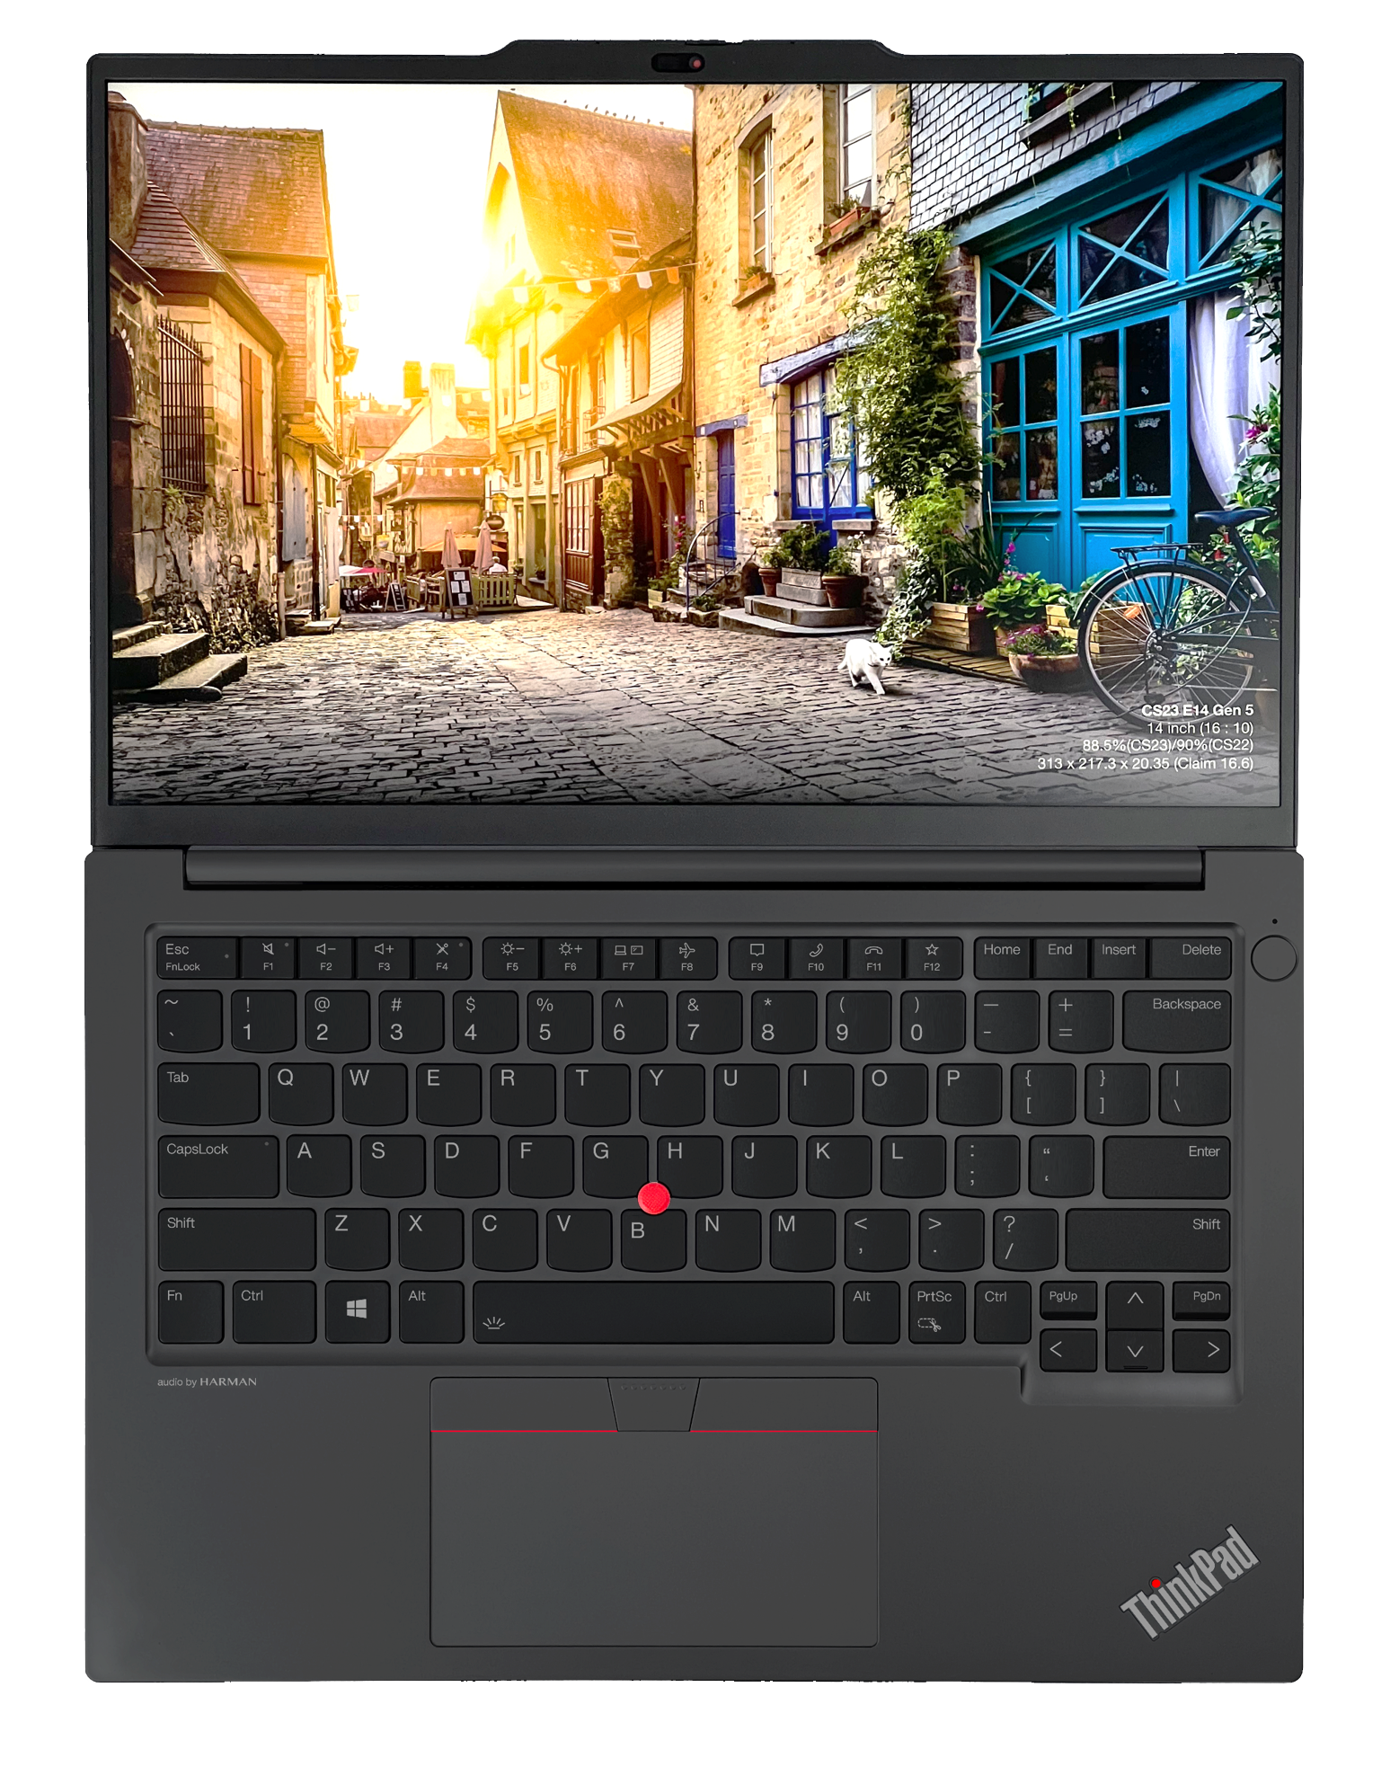
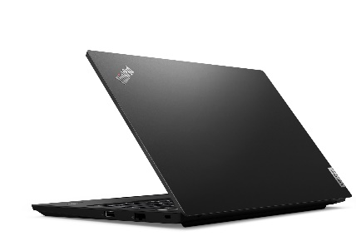
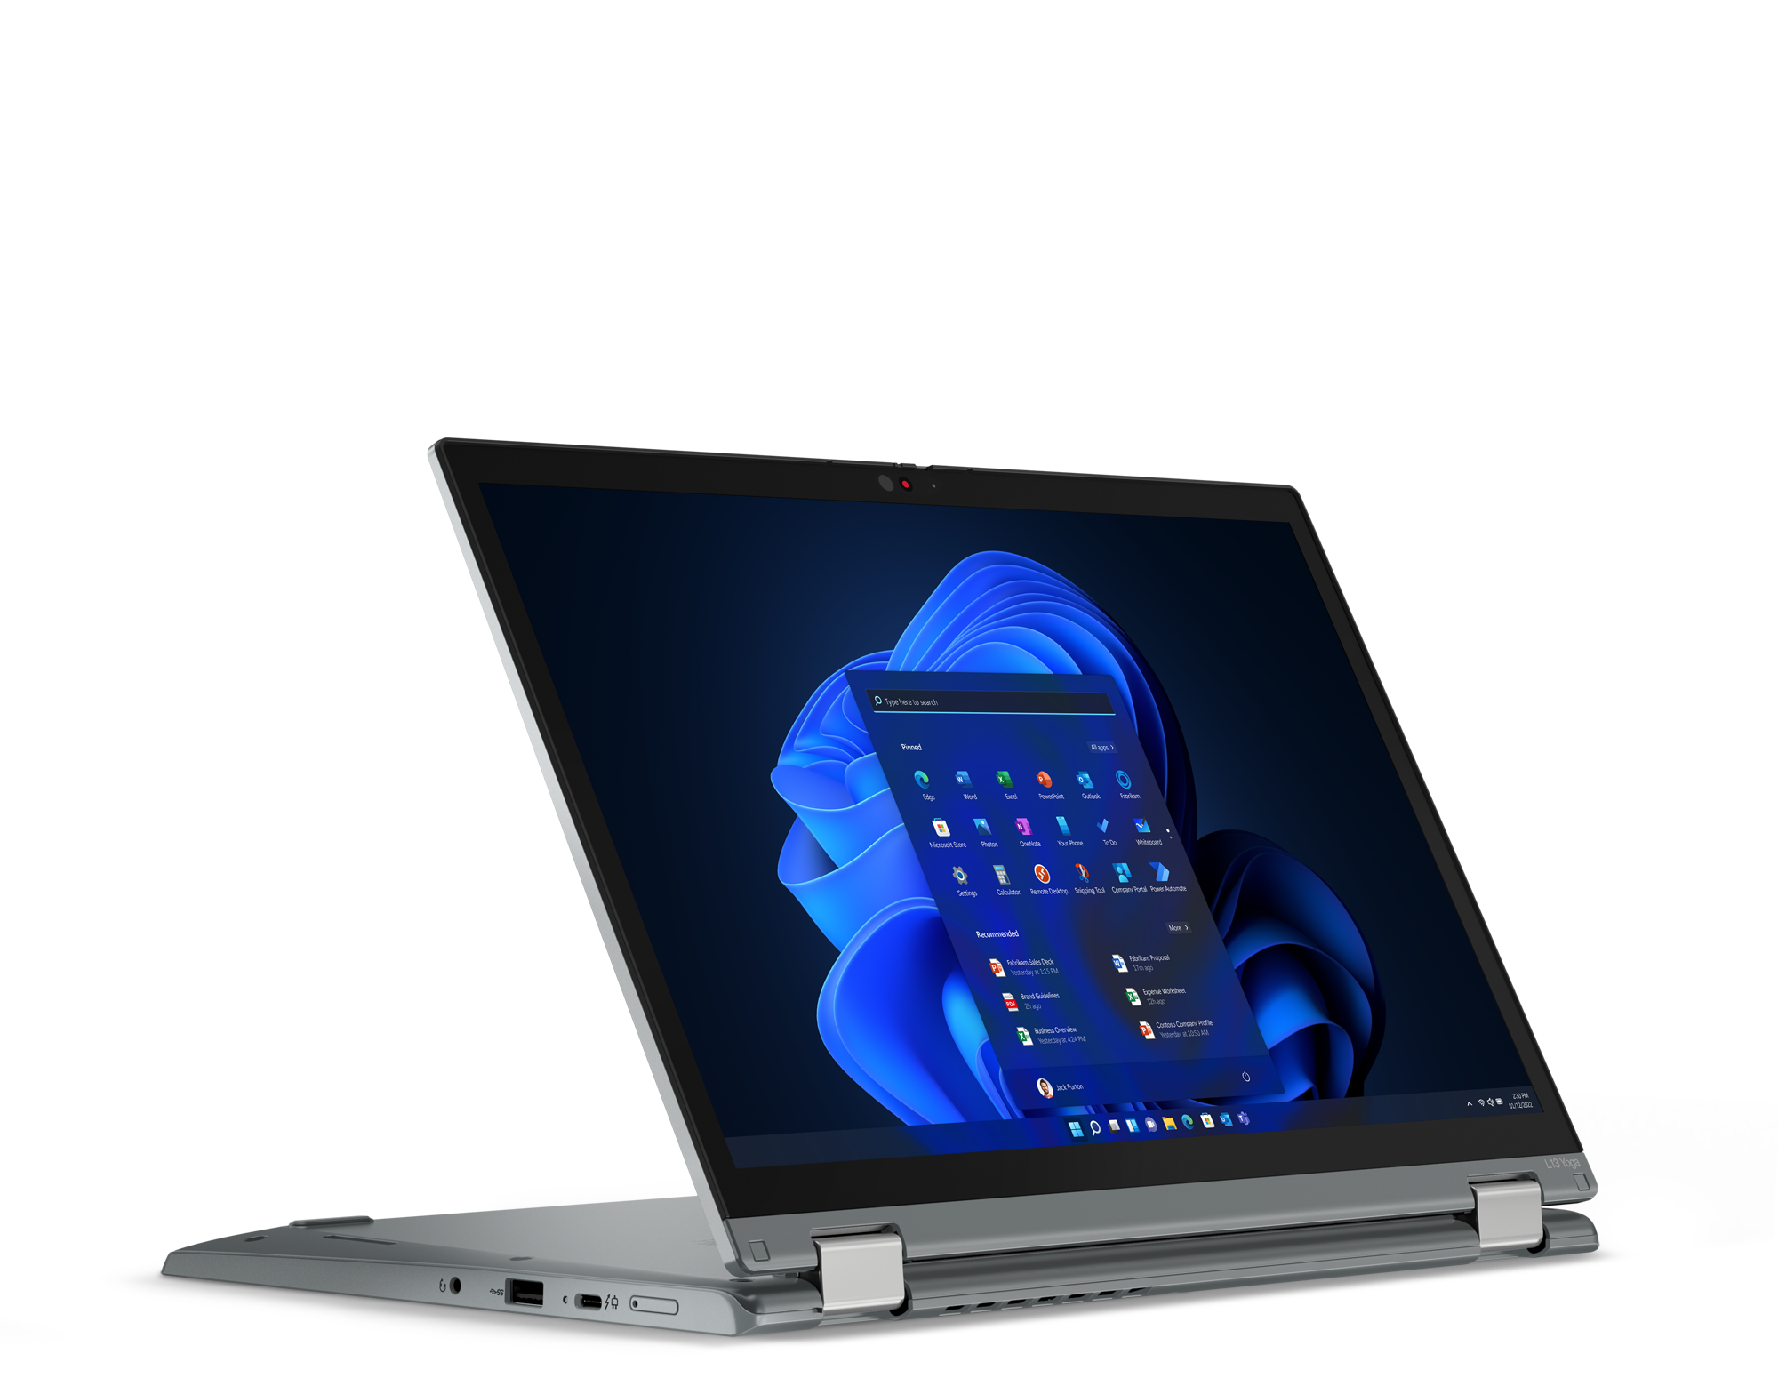
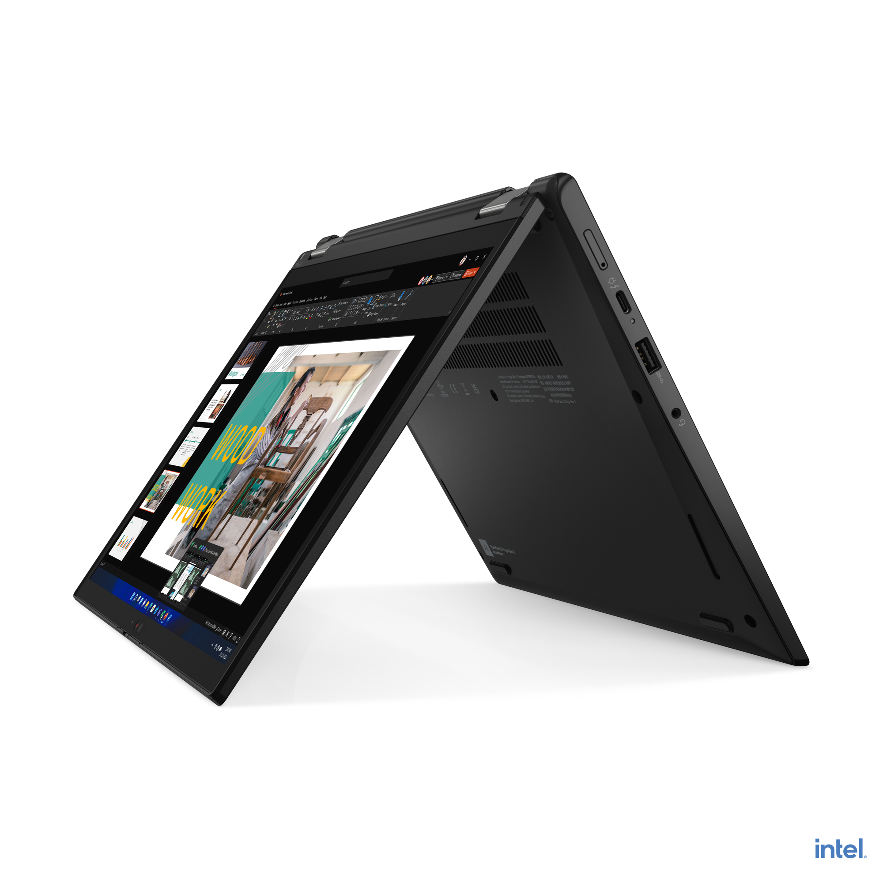
VELOCITY THINKPAD
E14 (Intel / AMD)
E16 (Intel/AMD)
L13 Yoga

Slide 10
VELOCITY THINKPAD – E Series
E14 G5 (Intel) | $909 | $979 | $1099
 | Rebate: $25 | Rebate: $25 | Rebate: $40
 | 21JK0084US | 21JK0052US | 21JK0053US
 | Core i5-1335U | Core i5-1335U | Core i7-1355U
 | 2 x 8GB DIMM | 2 x 8GB DIMM | 2 x 8GB DIMM
 | 256GB SSD NVMe | 512GB SSD NVMe | 512GB SSD NVMe
 | 14” WUXGA IPS Anti-glare | 14” WUXGA IPS Anti-glare, Touch | 14” WUXGA IPS Anti-glare, Touch
 | FHD Camera w/Shutter, 2x2 AX WLAN, BT | FHD Camera w/Shutter, 2x2 AX WLAN, BT | FHD Camera w/Shutter, 2x2 AX WLAN, BT
 | Integrated 47Whr Battery | Integrated 47Whr Battery | Integrated 47Whr Battery
 | Win11 Pro | Win11 Pro | Win11 Pro
 | 1 Year Depot | 1 Year Depot | 1 Year Depot
E14 G5 (AMD) | $649 | $829 | $949 | $979
 |  | Rebate: $25 | Rebate: $25 | Rebate: $50
 | 21JR001QUS | 21JR001RUS | 21JR001SUS | 21JR0018US
 | Ryzen 5 7530U | Ryzen 5 7530U | Ryzen 7 7730U | Ryzen 7 7730U
 | 1 x 8GB DIMM | 2 x 8GB DIMM | 2 x 8GB DIMM | 2 x 8GB DIMM
 | 256GB SSD NVMe | 256GB SSD NVMe | 512GB SSD NVMe | 512GB SSD NVMe
 | 14” WUXGA IPS Anti-glare | 14” WUXGA IPS Anti-glare | 14” WUXGA IPS Anti-glare | 14” WUXGA IPS Anti-glare, Touch
 | FHD Camera w/Shutter, 2x2 AX WLAN, BT | FHD Camera w/Shutter, 2x2 AX WLAN, BT | FHD Camera w/Shutter, 2x2 AX WLAN, BT | FHD Camera w/Shutter, 2x2 AX WLAN, BT
 | Integrated 47Whr Battery | Integrated 47Whr Battery | Integrated 47Whr Battery | Integrated 47Whr Battery
 | Win11 Pro | Win11 Pro | Win11 Pro | Win11 Pro
 | 1 Year Depot | 1 Year Depot | 1 Year Depot | 1 Year Depot
E16 G1 (Intel) | $909 | $979 | $1079 | $1099
 | Rebate: $25 | Rebate: $25 | Rebate: $40 | Rebate: $40
 | 21JN003YUS | 21JN0040US | 21JN0073US | 21JN003XUS
 | Core i5-1335U | Core i5-1335U | Core i7-1355U | Core i7-1355U
 | 2 x 8GB DIMM | 2 x 8GB DIMM | 2 x 8GB DIMM | 2 x 8GB DIMM
 | 256GB SSD NVMe | 512GB SSD NVMe | 512GB SSD NVMe | 512GB SSD NVMe
 | 16” WUXGA IPS Anti-glare | 16” WUXGA IPS Anti-glare, Touch | 16” WUXGA IPS Anti-glare | 16” WUXGA IPS Anti-glare, Touch
 | FHD Camera w/Shutter, 2x2 AX WLAN, BT | FHD Camera w/Shutter, 2x2 AX WLAN, BT | FHD Camera w/Shutter, 2x2 AX WLAN, BT | FHD Camera w/Shutter, 2x2 AX WLAN, BT
 | Integrated 47Whr Battery | Integrated 47Whr Battery | Integrated 47Whr Battery | Integrated 47Whr Battery
 | Win11 Pro | Win11 Pro | Win11 Pro | Win11 Pro
 | 1 Year Depot | 1 Year Depot | 1 Year Depot | 1 Year Depot
E16 G1 (AMD) | $649 | $829 | $949 | $979
 |  | Rebate: $25 | Rebate: $25 | Rebate: $50
 | 21JT001PUS | 21JT001BUS | 21JT001QUS | 21JT001AUS
 | Ryzen 5 7530U | Ryzen 5 7530U | Ryzen 7 7730U | Ryzen 7 7730U
 | 1 x 8GB DIMM | 2 x 8GB DIMM | 2 x 8GB DIMM | 2 x 8GB DIMM
 | 256GB SSD NVMe | 256GB SSD NVMe | 512GB SSD NVMe | 512GB SSD NVMe
 | 16” WUXGA IPS Anti-glare | 16” WUXGA IPS Anti-glare | 16” WUXGA IPS Anti-glare | 16” WUXGA IPS Anti-glare, Touch
 | FHD Camera w/Shutter, 2x2 AX WLAN, BT | FHD Camera w/Shutter, 2x2 AX WLAN, BT | FHD Camera w/Shutter, 2x2 AX WLAN, BT | FHD Camera w/Shutter, 2x2 AX WLAN, BT
 | Integrated 47Whr Battery | Integrated 47Whr Battery | Integrated 47Whr Battery | Integrated 47Whr Battery
 | Win11 Pro | Win11 Pro | Win11 Pro | Win11 Pro
 | 1 Year Depot | 1 Year Depot | 1 Year Depot | 1 Year Depot

Slide 11
VELOCITY THINKPAD – L Series
L13 G4 Yoga (Intel) | $1449 | $1589
 | 21FJ002CUS | 21FJ002DUS
 | Core i5-1335U | Core i7-1355U
 | 16GB DIMM | 16GB DIMM
 | 512GB SSD NVMe | 512GB SSD NVMe
 | 13.3” WUXGA IPS Anti-glare Touch | 13.3” WUXGA IPS Anti-glare Touch
 | HD Camera w/Shutter, FPR, 2x2 AX WLAN, BT, Backlit Keyboard, Black | IR Camera w/Shutter, FPR, 2x2 AX WLAN, BT, Backlit Keyboard, Black
 | Integrated 46Whr Battery | Integrated 46Whr Battery
 | Win11 Pro | Win11 Pro
 | 3 Year Depot | 3 Year Depot

Slide 12
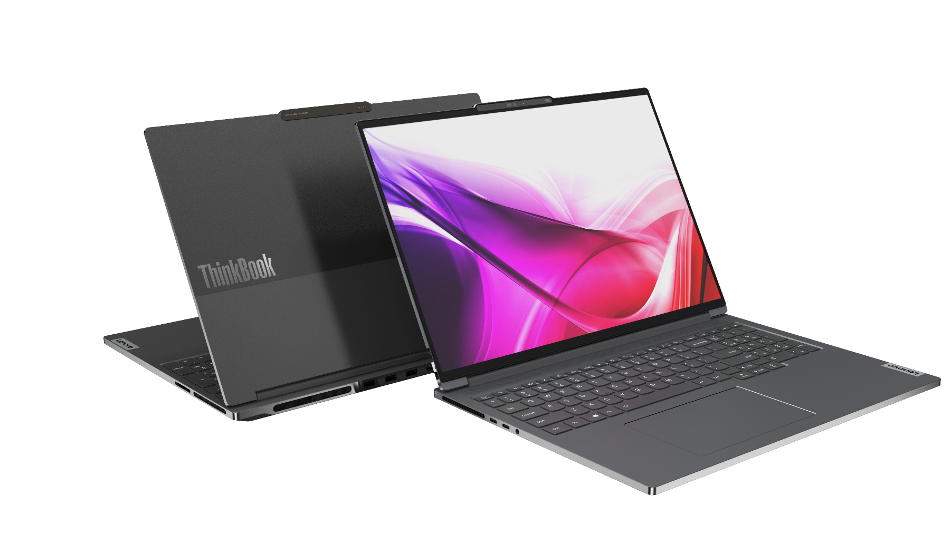
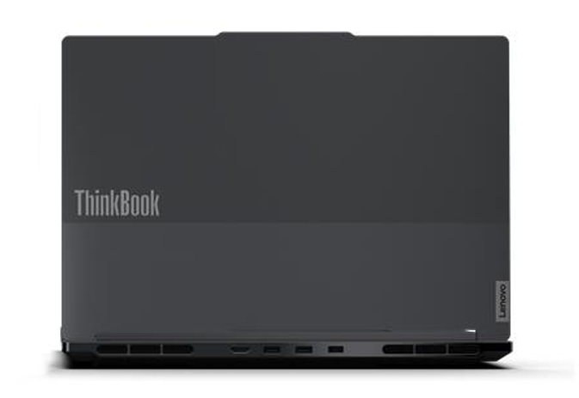
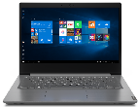
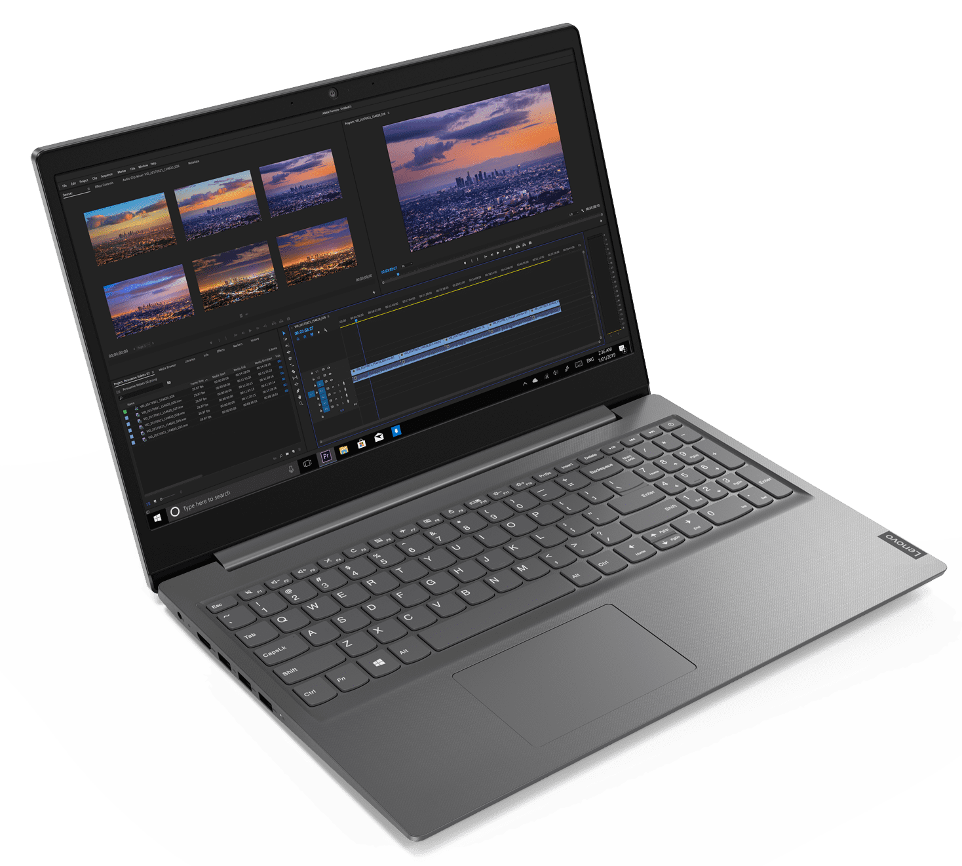
LENOVO TOPSELLER NOTEBOOKS
ThinkBook 14 (Intel / AMD)
ThinkBook 16 (Intel / AMD)
Lenovo V14
Lenovo V15

Slide 13
VELOCITY NOTEBOOKS – ThinkBook
ThinkBook 14 G6 (Intel) | $899 | $969 | $1099
 | Rebate: $25 | Rebate: $25 | Rebate: $50
 | 21KG0005US | 21KG000AUS | 21KG000FUS
 | Core i5-1335U | Core i5-1335U | i7-1355U
 | 2 x 8GB DIMM | 2 x 8GB DIMM | 2 x 8GB DIMM
 | 256GB SSD NVMe | 512GB SSD NVMe | 512GB SSD NVMe
 | 14” WUXGA IPS Anti-glare | 14” WUXGA IPS Anti-glare Touch | 14” WUXGA IPS Anti-glare Touch
 | FHD Camera w/Shutter, 2x2 AX WLAN, BT, Backlit Keyboard, Aluminum | FHD Camera w/Shutter, 2x2 AX WLAN, BT, Backlit Keyboard, Aluminum | FHD Camera w/Shutter, 2x2 AX WLAN, BT, Backlit Keyboard, Aluminum
 | Integrated 45Whr Battery | Integrated 45Whr Battery | Integrated 45Whr Battery
 | Win11 Pro | Win11 Pro | Win11 Pro
 | 1 Year Depot | 1 Year Depot | 1 Year Depot
ThinkBook 14 G6 (AMD) | $679 | $869 | $959
 |  | Rebate: $25 | Rebate: $40
 | 21KJ0004US | 21KJ0009US | 21KJ000EUS
 | Ryzen 5 7530U | Ryzen 5 7530U | Ryzen 7 7730U
 | 1 x 8GB DIMM | 2 x 8GB DIMM | 2 x 8GB DIMM
 | 256GB SSD NVMe | 512GB SSD NVMe | 512GB SSD NVMe
 | 14” WUXGA IPS Anti-glare | 14” WUXGA IPS Anti-glare Touch | 14” WUXGA IPS Anti-glare Touch
 | FHD Camera w/Shutter, 2x2 AX WLAN, BT, Backlit Keyboard, Aluminum | FHD Camera w/Shutter, 2x2 AX WLAN, BT, Backlit Keyboard, Aluminum | FHD Camera w/Shutter, 2x2 AX WLAN, BT, Backlit Keyboard, Aluminum
 | Integrated 45Whr Battery | Integrated 45Whr Battery | Integrated 45Whr Battery
 | Win11 Pro | Win11 Pro | Win11 Pro
 | 1 Year Depot | 1 Year Depot | 1 Year Depot
ThinkBook 14s Yoga G3 | $1099 | $1149 | $1269
 | Rebate: $25 | Rebate: $25 | Rebate: $40
 | 21JG0019US | 21JG0018US | 21JG001FUS
 | Core i5-1335U | Core i5-1335U | Core i7-1355U
 | 8GB DIMM + 8GB DIMM | 8GB DIMM + 8GB DIMM | 8GB DIMM + 8GB DIMM
 | 256GB SSD NVMe | 512GB SSD NVMe | 512GB SSD NVMe
 | 14” FHD IPS Touch sRGB | 14” FHD IPS Touch sRGB | 14” FHD IPS Touch sRGB
 | Camera w/Shutter, FPR, 2x2 AX WLAN, BT, Aluminum, Backlit Keyboard | Camera w/Shutter, FPR, 2x2 AX WLAN, BT, Aluminum, Backlit Keyboard | Camera w/Shutter, FPR, 2x2 AX WLAN, BT, Aluminum, Backlit Keyboard
 | Integrated 60Whr Battery | Integrated 60Whr Battery | Integrated 60Whr Battery
 | Win11 Pro | Win11 Pro | Win11 Pro
 | 1 Year Depot | 1 Year Depot | 1 Year Depot

Slide 14
VELOCITY NOTEBOOKS – ThinkBook
ThinkBook 16 G6 Intel | $889 | $989 | $1119
 | Rebate: $25 | Rebate: $25 | Rebate: $50
 | 21KH0005US | 21KH000AUS | 21KH000FUS
 | Core i5-1335U | Core i5-1335U | i7-1355U
 | 2 x 8GB DIMM | 2 x 8GB DIMM | 2 x 8GB DIMM
 | 256GB SSD NVMe | 512GB SSD NVMe | 512GB SSD NVMe
 | 16” WUXGA IPS Anti-glare | 16” WUXGA IPS Anti-glare Touch | 16” WUXGA IPS Anti-glare Touch
 | FHD Camera w/Shutter, 2x2 AX WLAN, BT, Backlit Keyboard, Aluminum | FHD Camera w/Shutter, 2x2 AX WLAN, BT, Backlit Keyboard, Aluminum | FHD Camera w/Shutter, 2x2 AX WLAN, BT, Backlit Keyboard, Aluminum
 | Integrated 45Whr Battery | Integrated 45Whr Battery | Integrated 45Whr Battery
 | Win11 Pro | Win11 Pro | Win11 Pro
 | 1 Year Depot | 1 Year Depot | 1 Year Depot
ThinkBook 16 G6 AMD | $679 | $889 | $979
 |  | Rebate: $25 | Rebate: $40
 | 21KK0004US | 21KK0009US | 21KK000EUS
 | Ryzen 5 7530U | Ryzen 5 7530U | Ryzen 7 7730U
 | 1 x 8GB DIMM | 2 x 8GB DIMM | 2 x 8GB DIMM
 | 256GB SSD NVMe | 512GB SSD NVMe | 512GB SSD NVMe
 | 16” WUXGA IPS Anti-glare | 16” WUXGA IPS Anti-glare Touch | 16” WUXGA IPS Anti-glare Touch
 | FHD Camera w/Shutter, 2x2 AX WLAN, BT, Backlit Keyboard, Aluminum | FHD Camera w/Shutter, 2x2 AX WLAN, BT, Backlit Keyboard, Aluminum | FHD Camera w/Shutter, 2x2 AX WLAN, BT, Backlit Keyboard, Aluminum
 | Integrated 45Whr Battery | Integrated 45Whr Battery | Integrated 45Whr Battery
 | Win11 Pro | Win11 Pro | Win11 Pro
 | 1 Year Depot | 1 Year Depot | 1 Year Depot
ThinkBook G4 16p | $1649 | $1929
 | Rebate: $350 | Rebate: $420
 | 21J8002LUS | 21J8002RUS
 | Core i5-13500H | Core i7-13700H
 | 16GB DIMM | 16GB DIMM
 | 512GB SSD NVMe | 512GB SSD NVMe
 | 16" WQXGA (2560x1600) IPS 400nits Anti-glare, 100% sRGB, 60Hz, Dolby® Vision | 16" WQXGA (2560x1600) IPS 400nits Anti-glare, 100% sRGB, 60Hz, Dolby® Vision
 | FHD 1080p + IR Hybrid with Privacy Shutter, FPR, Backlit Keyboard | FHD 1080p + IR Hybrid with Privacy Shutter, FPR, Backlit Keyboard
 | Integrated 80Wh | Integrated 80Wh
 | Win11 Pro | Win11 Pro
 | 1 Year Depot | 1 Year Depot

Slide 15
VELOCITY NOTEBOOKS – V Series
Lenovo V14 G4 – AMD | $529
 | Rebate: $50
 | 82YX000BUS
 | AMD R5 5500U
 | 1 x 8 GB (soldered)
 | 256 SSD M.2 NVMe
 | 14” FHD TN Anti-glare
 | HD Camera w/Shutter, 2x2 AX WLAN, BT
 | Integrated 38Whr Battery
 | Win 11 Pro
 | 1 Year Depot
Lenovo V14 G4 - Intel | $599 | $699
 | Rebate: $40 | Rebate: $35
 | 83A0004GUS | 83A00023US
 | Intel Core i3-1315U | Intel Core i5-1335U
 | 8 GB (2 x 4GB DDR) | 1 x 8GB DIMM
 | 256 SSD M.2 NVMe | 256 SSD M.2 NVMe
 | 14” FHD TN Anti-glare | 14” FHD TN Anti-glare
 | HD Camera w/Shutter, 2x2 AX WLAN, BT | HD Camera w/Shutter, 2x2 AX WLAN, BT
 | Integrated 38Whr Battery | Integrated 38Whr Battery
 | Win 11 Pro | Win 11 Pro
 | 1 Year Depot | 1 Year Depot
Lenovo V15 G4 - AMD | $529
 | Rebate: $50
 | 83CR0005US
 | AMD R5 5500U
 | 1 x 8 GB (soldered)
 | 256 SSD M.2 NVMe
 | 15.6” FHD TN Anti-glare
 | HD Camera w/Shutter, 2x2 AX WLAN, BT
 | Integrated 38Whr Battery
 | Win 11 Pro
 | 1 Year Depot
Lenovo V15 G4 - Intel | $599 | $699
 | Rebate: $40 | Rebate: $35
 | 83A10028US | 83A10024US
 | Intel Core i3-1315U | Intel Core i5-1335U
 | 8 GB (2 x 4GB DDR) | 1 x 8GB DIMM
 | 256 SSD M.2 NVMe | 256 SSD M.2 NVMe
 | 15.6” FHD TN Anti-glare | 15.6” FHD TN Anti-glare
 | HD Camera w/Shutter, 2x2 AX WLAN, BT | HD Camera w/Shutter, 2x2 AX WLAN, BT
 | Integrated 38Whr Battery | Integrated 38Whr Battery
 | Win 11 Pro | Win 11 Pro
 | 1 Year Depot | 1 Year Depot

Slide 16
Tablets

Slide 17
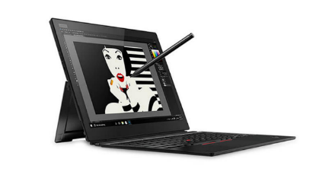
Tablets
X1 Tablet | $1,699 | $1,849
 | 20KJ0019US | 20KJ0017US
 | Core i5-8350u | Core i7-8650u
 | 8GB | 8GB
 | 256GB PCIe SSD | 256GB PCIe SSD
 | 13” QHD+ Touch | 13” QHD+ Touch
 | Camera, BT, FPR, Backlit. pen | Camera, BT, FPR, Backlit. pen
 | 3 Cell Battery | 3 Cell Battery
 | Win 10 Pro | Win 10 Pro
 | 3 Year Depot | 3 Year Depot
Tablet 10 | $529
 | 20L3000HUS
 | Celeron N4100
 | 4GB
 | 128GB eMMC
 | 10.1” WUXGA Touch
 | Camera, BT, FPR, Garaged Pen
 | 10.6mm / 1.46lbs
 | Win 10 Pro
 | 1 Year Depot

Slide 18

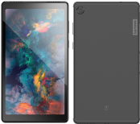
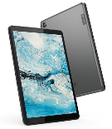
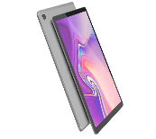
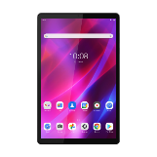
LENOLENOVO TOPSELLER - Android Focus Models R
Android Focus Models
Tab M8 HD | Tab M8 HD LTE (For Business) | Tab M10 FHD Plus | K10
$129.99 | $209 | $179.99 | $229.99
ZA5G0132US | ZA790003US | ZA5T0423US | ZA8N0064US​
8”HD Display | 8”HD Display | 10.3” FHD Display | 10.3” FHD Display
Android 10 | Android 10 | Android 10 | Android 11
Quad Core Processor | Quad Core Processor | Octa Core Processor | Octa Core Processor
2/5 MP Camera | 2/5 MP Camera | 2/5 MP Camera | 5/8 MP Camera
2/16 GB RAM and Storage | 2/32 GB RAM and Storage | 2/32 GB RAM and Storage | 3/32 GB RAM and Storage
2*Dolby Audio Speakers | 2*Dolby Audio Speakers | 2*Dolby Audio Speakers | 2*Dolby Audio Speakers
2.4/5G. BT 5.0 | 2.4/5G. BT 5.0 Plus LTE | 2.4/5G. BT 5.0 | 2.4/5G. BT 5.0
5,000MAh Battery | 5,000MAh Battery | 5,000MAh Battery | 7,700MAh Battery
Micro USB Port | USB-C 2.0 Port | USB-C 2.0 Port | USB-C 2.0 Port
1 Year Depot Warranty | 1 Year Depot Warranty | 1 Year Depot Warranty | 1 Year Depot Warranty

Slide 19
LENOVO TOPSELLER
Android Top seller Models
New!
New!
New!
Model ​ | M8 HD​ | ST M8 HD​ | M8 HD​ | ST M8 HD​ | M10 FHD Plus​ | M10 FHD Plus​ | ST M10 FHD Plus w/ Alexa​ | P12 Pro Bundle ​ | K10 ​ | K10​ | K10​ | K10​ Batteryless | K10 LTE Batteryless​
MTM​ | ZA5G0132US​ | ZA5C0050US​ | ZA790003US​ | ZA790002US​ | ZA5T0423US​ | ZA5T0382US​ | ZA6M0055US​ | ZAAX0000US | ZA8N0064US​ | ZA8N0044US​ | ZA8S0000US​ | ZA8T0001US​ | ZA9K0000US​
MSRP​ | $129​ | $139​ | $209​ | $219​ | 179​ | $199​ | $189​ | $729 | $229​ | $249​ | $269​ | $219​ | $269​
Focus Model​ | YES​ | ​ | YES​ | ​ | YES​ | ​ | ​ | ​ | YES​ | ​ | ​ | ​ | ​
LTE​ | ​ | ​ | YES​ | YES​ | ​ | ​ | ​ | ​ | ​ | ​ | YES​ | ​ | YES​
Display​ | 8” HD​ | 8” HD​ | 8” HD​ | 8” HD​ | 10.3” FHD​ | 10.3” FHD​ | 10.3” FHD​ | 12.6” AMOLED | 10.3” FHD​ | 10.3” FHD​ | 10.3” FHD​ | 10.3” FHD​ | 10.3” FHD​
OS​ | 10​ | 10​ | 10​ | 10​ | 10​ | 10​ | 10​ | 10​ | 11​ | 11​ | 11​ | 11​ | 11​
Processor​ | Quad Core​ | Quad Core​ | Quad Core​ | Quad Core​ | Octa Core​ | Octa Core​ | Octa Core​ | Octa Core​ | Octa Core​ | Octa Core​ | Octa Core​ | Octa Core​ | Octa Core​
Camera​ | 2/5MP​ | 2/5MP​ | 2/5MP​ | 2/5MP​ | 5/8MP​ | 5/8MP​ | 5/8MP​ | 8/13MP​ | 5/8MP w/ Flash​ | 5/8MP w/ Flash​ | 5/8MP w/ Flash​ | 5/8MP w/ Flash​ | 5/8MP w/ Flash​
Ram/Storage​ | 2/16GB​ | 2/16GB​ | 2/32GB​ | 2/32GB​ | 2/32GB​ | 4/64GB​ | 2/32GB​ | 8/256GB​ | 3/32GB​ | 4/64GB​ | 3/32GB​ | 3/32GB​ | 4/64GB​
Audio​ | 2 x Dolby​ | 2 x Dolby​ | 2 x Dolby​ | 2 x Dolby​ | 2 x Dolby​ | 2 x Dolby​ | 2 x Dolby​ | 4 x JBL​ | 2 x Dolby​ | 2 x Dolby​ | 2 x Dolby​ | 2 x Dolby​ | 2 x Dolby​
Wireless​ | 2.4/5G, BT 5.0​ | 2.4/5G, BT 5.0​ | 2.4/5G, BT 5.0​ | 2.4/5G, BT 5.0​ | 2.4/5G, BT 5.0​ | 2.4/5G, BT 5.0​ | 2.4/5G, BT 5.0​ | 2.4/5G, WIFI6, BT 5.2​ | 2.4/5G, BT 5.0​ | 2.4/5G, BT 5.0​ | 2.4/5G, BT 5.0​ | 2.4/5G, BT 5.0​ | 2.4/5G, BT 5.0​
Battery​ | 5,000mAh​ | 5,000mAh​ | 5,000mAh​ | 5,000mAh​ | 5,000mAh​ | 5,000mAh​ | 5,000mAh​ | 10,200 mAh​ | 7,700 mAh​ | 7,700 mAh​ | 7,700 mAh​ | No Battery​ | No Battery​
Ports ​ | Micro USB​ | Micro USB​ | USB-C 2.0​ | USB-C 2.0​ | USB-C 2.0​ | USB-C 2.0​ | USB-C 2.0​ | USB-C 3.1​ | USB-C 2.0​ | USB-C 2.0​ | USB-C 2.0​ | USB-C 2.0​ | USB-C 2.0​
Features​ | ​ | Cradle​ | ​ | Cradle​ | ​ | ​ | Dock​ | Keyboard + Pen​ | 3Yr Life Cycle​ | 3Yr Life Cycle​ | 3Yr Life Cycle​ | 3Yr Life Cycle​ | 3Yr Life Cycle​
Mil Spec​ | NA​ | NA​ | NA​ | NA​ | NA​ | NA​ | NA​ | NA​ | NA​ | NA​ | NA​ | NA​ | NA​
Warranty​ | 1 Year Depot​ | 1 Year Depot​ | 1 Year Depot​ | 1 Year Depot​ | 1 Year Depot​ | 1 Year Depot​ | 1 Year Depot​ | 1 Year Depot​ | 1 Year Depot​ | 1 Year Depot​ | 1 Year Depot​ | 1 Year Depot​ | 1 Year Depot​

Slide 20
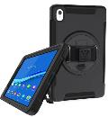
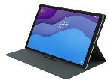

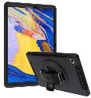
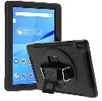
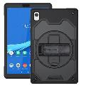
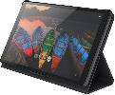
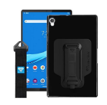
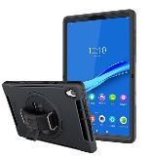
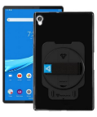
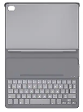
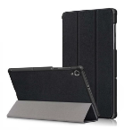
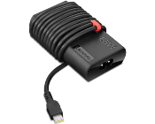

LENOVO Android Tablets Accessories
M8
M10
Tab M8 HD Folio Case
ZG38C02862
$14.99
Armor-X M8 HD/FHD
78016354
$39.99
Tab M10 FHD Plus Folio Case/Film
ZG38C02958
$19.99
Tab M10 FHD Plus Keyboard Case
ZG38C03371
$49.99
* Armor X
M10 FHD Plus X606F
MTM: 78016082
RIN-LN-M10PL
$39.99
* Armor X M10 FHD
MTM:78016083
RIN-LN-M10REL
$39.99
* Armor X M10 HD 2nd Gen | 306F
78016353
$39.99
K10
* Armor-X |K10 Shockproof case w/ kickstand, hand-strap, & X-MOUNT adapter
78019394
ZXS-LN-K10
$34.99
* Kastus Ant-Microbial Screen Protector
40F0KS2001
$29.99
Tab K10 Bluetooth Keyboard Case
ZG38C03597
$99
* Rugged case for Lenovo Tablet K10
78019381
RIN-LN-K10
$34.99
* Armor-X |K10 Shockproof Case w/ kickstand, revolving hand-strap
78019393
ZUN-LN-K10
$34.99
K10 Battery Less Power Adapter
4X20V24674
$69.99
*Armor-X | K10 Folio
78019392
*Contact Synnex for a quote with Armor-X part number. NSPs that purchase direct can use Lenovo MTM to order Lenovo Direct.

Slide 21
ThinkCentre & Lenovo Desktops

Slide 22
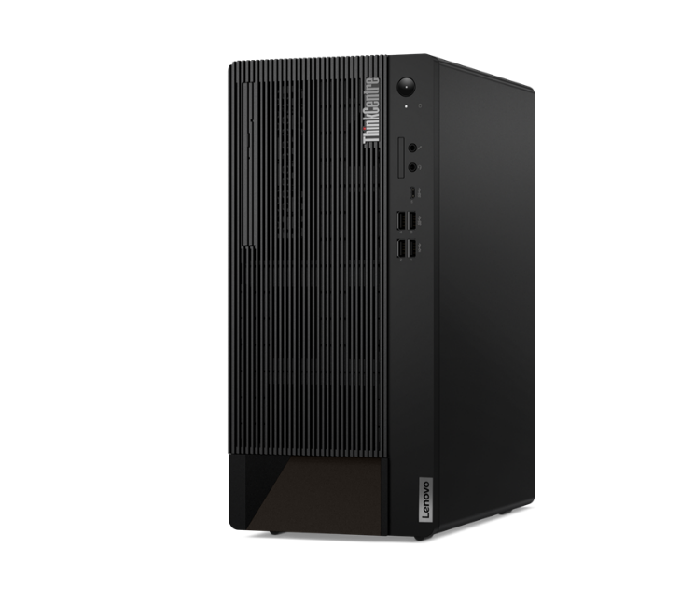
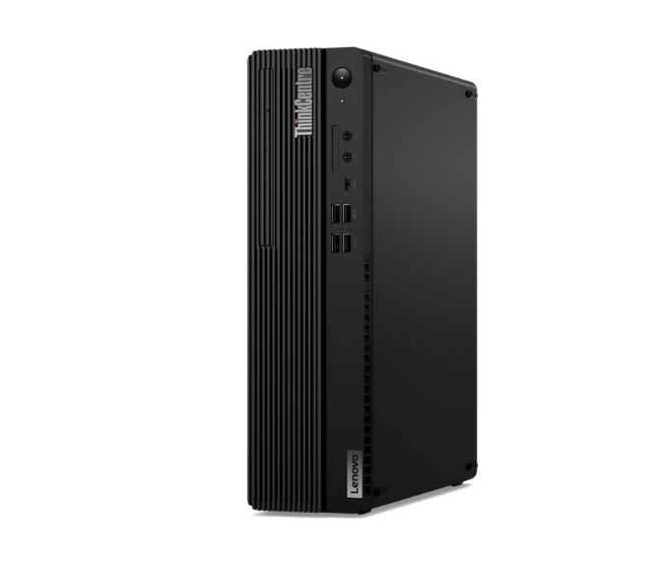
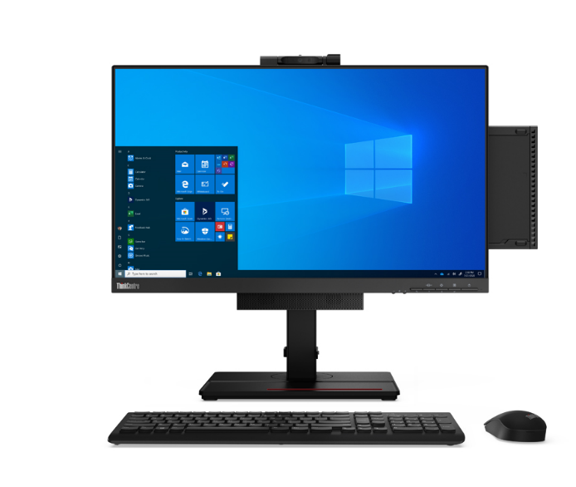
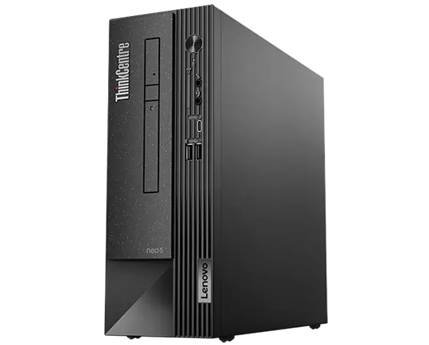
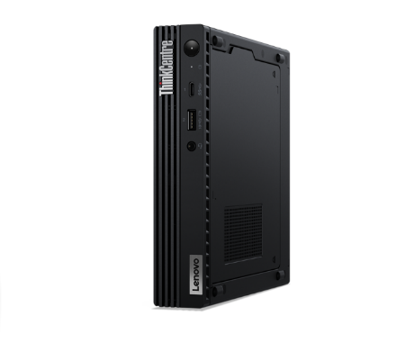
LENOVO TOPSELLER
ThinkCentre & Lenovo Desktops
LENOVO TOPSELLER
ThinkCentre & Lenovo Desktops
[ 1 OF 5 ]
ThinkCentre M75q Gen 2 Tiny (Pictured with optional Tiny-in-One)
ThinkCentre Tower
(M70t/M80t/M90t)
ThinkCentre
Small Form Factor
(M70s/M75s/M80s/M90s)
ThinkCentre Neo Small Form Factor
(Neo50s)
ThinkCentre Tiny
(Neo 50q/M70q/M75q/M80q/M90q)

Slide 23

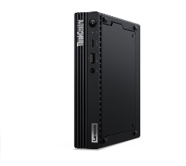
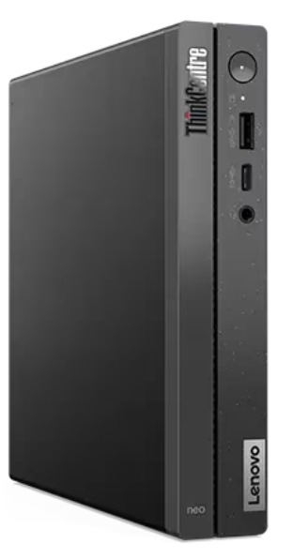
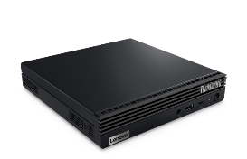
ThinkCentre Tiny Desktops
M75q Tiny Gen 2 | $669 | $769 | $829
 | $20 Rebate | $30 Rebate | $60 Rebate
 | 11JN008BUS | 11JN002PUS | 11JN0089US
 | Ryzen 3 PRO 5350GE | Ryzen 5 PRO 5650GE | Ryzen 5 PRO 5650GE
 | 8GB Memory | 8GB Memory | 16GB Memory
 | 256GB SSD M.2 PCIe | 256GB SSD M.2 PCIe | 256GB SSD M.2 PCIe
 | Win11 Pro 64 | Win11 Pro 64 | Win11 Pro 64
 | 3 Year Onsite | 3 Year Onsite | 3 Year Onsite
$989
$40 Rebate
11JN002RUS
Ryzen 7 PRO 5750GE
16GB Memory
512GB SS M.2 PCIe
Win11 Pro 64
3 Year Onsite
ThinkCentre M75q Gen 2 Tiny (Pictured with Tiny-in-One)
Neo 50q Gen 4 | $699 | $749
 | $50 Rebate | $50 Rebate
 | 12LN000CUS | 12LN000BUS
 | Core i5-13420H | Core i5-13420H
 | 8GB DDR4 2666MHz | 16GB DDR4 2666MHz
 | 256GB M.2 SSD | 256GB M.2 SSD
 | 2x2 AC Wi-Fi + BT 5.2 | 2x2 AC Wi-Fi + BT 5.2
 | DP + HDMI | DP + HDMI
 | Win11 Pro 64 | Win11 Pro 64
 | 1 Year Onsite | 1 Year Onsite
Neo 50q Gen 4

Slide 24
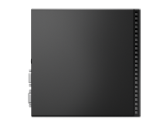


ThinkCentre Gen 3 Alderlake Tiny Desktops
M70q Tiny Gen 3 | $869 | $919 | $949 | $1,199
 | $100 Rebate | $100 Rebate | $50 Rebate | $50 Rebate
 | 11T3000BUS | 11T300C0US | 11T300C9US | 11T3000RUS
 | Core i5-12400T | Core i5-12400T | Core i5-12400T | Core i7-12700T
 | 8GB DDR4 2666MHz | 16GB DDR4 2666MHz | 16GB DDR4 2666MHz | 16GB DDR4 2666MHz
 | 256GB SSD M.2 PCIe | 256GB SSD M.2 PCIe | 512GB SSD M.2 PCIe | 256GB SSD M.2 PCIe
 | Win11 Pro 64 | Win11 Pro 64 | Win11 Pro 64 | Win11 Pro 64 Win10 DG
 | 3 Year Onsite | 3 Year Onsite | 3 Year Onsite | 3 Year Onsite
Prices shown do not include rebate (if available).
ThinkCentre M70q Tiny
[ 2 OF 3 ]
M80q Tiny Gen 3 | $989 | $1,029 | $1,399
 | $30 Rebate | $30 Rebate | $30 Rebate
 | 11U10010US | 11U10054US | 11U1000YUS
 | Core i5-12500T | Core i5-12500T | Core i7-12700T
 | 8GB DDR4 2666MHz | 16GB DDR4 2666MHz | 16GB DDR4 2666MHz
 | 256GB SSD M.2 PCIe | 256GB SSD M.2 PCIe | 512GB SSD M.2 PCIe
 | Win11 Pro 64 | Win11 Pro 64 | Win11 Pro 64
 | 3 Year Onsite | 3 Year Onsite | 3 Year Onsite
M90q Tiny Gen 3 | $1,079 | $1,159 | $1,199 | $1,499
 | $150 Rebate | $130 Rebate | $100 Rebate | $100 Rebate
 | 11U5000SUS | 11U50069US | 11U5004VUS | 11U50067US
 | Core i5-12500 | Core i5-12500 | Core i7-12700 | Core i7-12700
 | 8GB DDR4 2666MHz | 16GB DDR4 2666MHz | 16GB DDR4 2666MHz | 16GB DDR4 2666MHz
 | 256GB SSD M.2 PCIe | 256GB SSD M.2 PCIe | 512GB SSD M.2 PCIe | 512GB SSD M.2 PCIe
 | Win11 Pro 64 | Win11 Pro 64 | Win11 Pro 64 | Win11 Pro 64
 | 3 Year Onsite | 3 Year Onsite | 3 Year Onsite | 3 Year Onsite
ThinkCentre M80q Tiny
ThinkCentre M90q Tiny

Slide 25

ThinkCentre Small Form Factor Desktops
[ 5 OF 8 ]
Prices shown do not include rebate (if available).
Neo 50s Gen 4 | $729 | $759 | M75s Gen 2 ACN SFF | $709 | $799 | $1,039
 | $30 Rebate | $30 Rebate |  | $100 Rebate | $100 Rebate | $200 Rebate
 | 12JF0000US | 12JF0002US |  | 11R8004HUS | 11R8001XUS | 11R8004GUS
 | Core i5-13400 | Core i5-13400 |  | Ryzen 3 PRO 5350G | Ryzen 5 5650G | Ryzen 7 5750G
 | 8GB DDR4 2666MHz | 8GB DDR4 2666MHz |  | 8GB DDR4-3200 | 8GB DDR4-3200 | 16GB DDR4-3200
 | 128GB SSD M.2 PCIe | 256GB SSD M.2 PCIe |  | 256GB SSD M.2 PCIe | 256GB SSD M.2 PCIe | 256GB SSD M.2 PCIe
 | DVD RW | DVD RW |  | Radeon Graphics | Radeon Graphics | Radeon Graphics
 | VGA + DisplayPort | VGA + DisplayPort |  | Win11 Pro 64 | Win11 Pro 64 | Win11 Pro 64
 | Win11 Pro 64 | Win11 Pro 64 |  | 3 Year Onsite | 3 Year Onsite | 3 Year Onsite
 | 3 Year Onsite | 3 Year Onsite
M70s SFF Gen 3 | $959 | $999 | $1,269
 | $50 Rebate | $50 Rebate | $50 Rebate
 | 11T8001GUS | 11T8001WUS | 11T8001CUS
 | Core i5-12500 | Core i5-12500 | Core i7-12700
 | 16GB DDR4 2666MHz | 16GB DDR4 2933MHz | 16GB DDR4 2933MHz
 | 256GB SSD M.2 PCIe | 512GB SSD M.2 PCIe | 512GB SSD M.2 PCIe
 | DVD RW | DVD RW | DVD RW
 | 2 Display Ports | 2 Display Ports | 2 Display Ports
 | Win11 Pro 64 | Win11 Pro 64 | Win11 Pro 64
 | 3 Year Onsite | 3 Year Onsite | 3 Year Onsite
M80s SFF Gen 3 | $999 | $1,049
 | $50 Rebate | $30 Rebate
 | 11TG0008US | 11TG0001US
 | Core i5-12500 | Core i5-12500
 | 8GB DDR4 2666MHz | 16GB DDR4 2666MHz
 | 256GB SSD M.2 PCIe | 256GB SSD M.2 PCIe
 | DVD RW | DVD RW
 | 2 Display Ports | 2 Display Ports
 | Win11 Pro 64 | Win11 Pro 64
 | 3 Year Onsite | 3 Year Onsite
$1,359
$30 Rebate
11TG000AUS
Core i7-12700
16GB DDR4 2933MHz
512GB SSD M.2 PCIe
DVD RW
2 Display Ports
Win11 Pro 64
3 Year Onsite
M90s SFF Gen 3 | $1,169 | $1,189 | $1,459
 | $50 Rebate | $50 Rebate | $50 Rebate
 | 11TT000JUS | 11TT000SUS | 11TT001EUS
 | Core i5-12500 | Core i5-12500 | Core i7-12700
 | 16GB DDR4 2666MHz | 16GB DDR4 2933MHz | 16GB DDR4 2933MHz
 | 256GB SSD M.2 PCIe | 512GB SSD M.2 PCIe | 512GB SSD M.2 PCIe
 | DVD RW | DVD RW | DVD RW
 | 2 Display Ports | 2 Display Ports | 2 Display Ports
 | Win11 Pro 64 Win10 DG | Win11 Pro 64 Win10 DG | Win11 Pro 64 Win10 DG
 | 3 Year Onsite | 3 Year Onsite | 3 Year Onsite
ThinkCentre M90s SFF

Slide 26


ThinkCentre Mini Tower Desktops
[ 6 OF 8 ]
Prices shown do not include rebate (if available).
M70t Tower Gen 3 | $969 | $1,009 | $1,259
 | $50 Rebate | $50 Rebate | $50 Rebate
 | 11T6001YUS | 11T6001PUS | 11T6001SUS
 | Core i5-12400 | Core i5-12400 | Core i7-12700
 | 16GB DDR4 2666MHz | 16GB DDR4 2666MHz | 16GB DDR4 2933MHz
 | 256GB SSD M.2 PCIe | 512GB SSD M.2 PCIe | 512GB SSD M.2 PCIe
 | DVD RW | DVD RW | DVD RW
 | Win11 Pro 64 | Win11 Pro 64 | Win11 Pro 64
 | 3 Year Onsite | 3 Year Onsite | 3 Year Onsite
M80t Tower Gen 3 | $1,069 | $1,109 | $1,379
 | $50 Rebate | $50 Rebate | $50 Rebate
 | 11TE0000US | 11TE000EUS | 11TE0008US
 | Core i5-12400 | Core i5-12400 | Core i7-12700
 | 16GB DDR4 2666MHz | 16GB DDR4 2666MHz | 16GB DDR4 2933MHz
 | 256GB SSD M.2 PCIe | 512GB SSD M.2 PCIe | 512GB SSD M.2 PCIe
 | DVD RW | DVD RW | DVD RW
 | Win11 Pro 64 | Win11 Pro 64 | Win11 Pro 64
 | 3 Year Onsite | 3 Year Onsite | 3 Year Onsite

Slide 27





ThinkCentre All-in-One Desktops
Prices shown do not include rebate (if available).
M70a All-in-One Gen 3 | $1,289 | $1,319
 | 11VL0048US | 11VL003SUS
 | 21.5” 1080p Non-Touch Display | 21.5” 1080p Multi-Touch Display
 | Core i5-12400 | Core i5-12400
 | 8GB DDR4 2666MHz | 8GB DDR4 2666MHz
 | 256GB SSD M.2 PCIe NVMe Opal | 256GB SSD M.2 PCIe NVMe Opal
 | DVD RW, Wi-Fi+BT, Webcam/Mic | DVD RW, Wi-Fi+BT, Webcam/Mic
 | DP Out, UltraFlex IV Stand | DP Out, UltraFlex IV Stand
 | Win11 Pro 64 | Win11 Pro 64
 | 3 Year Onsite | 3 Year Onsite
M90a All-in-One Gen 3 | $1,359 | $1,459
 | 11VF0067US | 11VF0065US
 | 21.5” 1080p Non-Touch Display | 21.5” 1080p Multi-Touch Display
 | Core i5-12400 | Core i5-12400
 | 8GB DDR4 2666MHz | 8GB DDR4 2666MHz
 | 256GB SSD M.2 PCIe NVMe Opal | 256GB SSD M.2 PCIe NVMe Opal
 | DVD RW, Wi-Fi+BT, Webcam/Mic | DVD RW, Wi-Fi+BT, Webcam/Mic
 | DP Out, UltraFlex Stand | DP Out, UltraFlex Stand
 | Win11 Pro 64 | Win11 Pro 64
 | 3 Year Onsite | 3 Year Onsite

Slide 28





ThinkVision Monitors
[ 8 OF 8 ]
Prices shown do not include rebate (if available).
ThinkCentre Tiny-in-One 27
TINY-IN-ONE 4
Price is Monitor Only.
ThinkCentre Tiny (Pictured) Sold Separately
ThinkCentre Tiny-in-One 22
Tiny-in-One 22 Monitor | $274
 | 11GSPAR1US
 | 21.5” WLED Borderless Panel
 | 1080p Non-Touch Display
 | 720p Webcam w/ Dual Mic and ThinkShutter Cover
 | 1 x USB Type A port (Side)
 | Tiny PC Compatibility (AIO Mode)
 | DisplayPort In (Monitor Mode)
 | Lift / Tilt / Pivot Stand Adjustment
 | 3 Year Adv. Exchange Warranty
Tiny-in-One 24 Monitor | $294
 | 11GDPAR1US
 | 23.8” WLED Borderless Panel
 | 1080p Non-Touch Display
 | 1080p Webcam w/ Dual Mic
 | 1 x USB Type A port (Side)
 | Tiny PC Compatibility (AIO Mode)
 | DisplayPort In (Monitor Mode)
 | Lift / Tilt / Pivot Stand Adjustment
 | 3 Year Adv. Exchange Warranty
Tiny-in-One 27 Monitor | $434
 | 11JHRAR1US
 | 27” WLED Borderless Panel
 | 1440p Non-Touch Display
 | 1080p RGB/IR Webcam w/ Dual Mic
 | 2 x USB 3.1 port (Side)
 | Tiny PC Compatibility (AIO Mode)
 | DisplayPort / HMDI In (Monitor Mode)
 | Lift / Tilt / Pivot Stand Adjustment
 | 3 Year Adv. Exchange Warranty
Tiny-in-One 24 Touch Monitor | $354
 | 11GCPAR1US
 | 23.8” WLED Borderless Panel
 | 1080p Touch Display
 | 720p Webcam w/ Dual Mic
 | 1 x USB A port (Side)
 | Tiny PC Compatibility (AIO Mode)
 | DisplayPort In (Monitor Mode)
 | Lift / Tilt / Pivot Stand Adjustment
 | 3 Year Adv. Exchange Warranty

Slide 29
Mobile Workstations & ThinkStation

Slide 30







Lenovo Topseller ThinkPad Mobile Workstations
ThinkPad P14s Intel
ThinkPad P14s AMD
Ultra-portable 14-inch
with all-day battery
ThinkPad P16s Intel
ThinkPad P16s AMD
Thin & light 16-inch with all-day battery
ThinkPad P16v Intel
ThinkPad P15v/T15p Intel
ThinkPad P15v/P16v AMD
Value 15.6/16-inch
NVIDIA professional (P16v/P15v) or consumer GeForce graphics (T15p)
ThinkPad P1
Ultra-premium 16-inch*
Now even more performance up to NVIDIA RTX 5000 Ada graphics
ThinkPad P16
Ultra-Performance 16-inch
Intel HX CPUs with
up to NVIDIA RTX 5000 Ada graphics

Slide 31
Lenovo Topseller ThinkPad Mobile Workstations
P14s & P16s Intel | Ultraportable performance
P14s Gen 4 14” Ultra-portable | $1,679 | $1,799 | $2,049 | $2,099 | $2,269 | $2,429
 | $475 Rebate | $75 Rebate | $140 Rebate | $100 Rebate | $100 Rebate | $100 Rebate
 | 21HF000CUS | 21HF000AUS | 21HF001KUS | 21HF001TUS | 21HF001MUS | 21HF001NUS
 | Core i5-1340P | Core i7-1360P | Core i7-1360P | Core i7-1370P vPro | Core i7-1360P | Core i7-1370P vPro
 | 16GB DDR5 5200 | 16GB DDR5 5200 | 16GB LPDDR5 4800 | 16GB LPDDR5 4800 | 32GB LPDDR5 4800 | 32GB LPDDR5 4800
 | 512GB PCIe SSD | 512GB PCIe SSD | 512GB PCIe SSD | 512GB PCIe SSD | 1TB PCIe SSD | 1TB PCIe SSD
 | 14” 16:10 WUXGA (FHD+) IPS 5MP-IR Camera | 14” 16:10 WUXGA (FHD+) IPS 5MP-IR Camera | 14” 16:10 WUXGA (FHD+) IPS touch 5MP-IR Camera | 14” 16:10 WUXGA (FHD+) IPS 5MP-IR Camera | 14” 16:10 WUXGA (FHD+) IPS 5MP-IR Camera | 14” 16:10 WUXGA (FHD+) IPS touch 5MP-IR Camera
 | Intel UHD Graphics | Intel UHD Graphics | NVIDIA RTX A500 4GB | NVIDIA RTX A500 4GB | NVIDIA RTX A500 4GB | NVIDIA RTX A500 4GB
 | Win 11 Pro 64 | Win 11 Pro 64 | Win 11 Pro 64 | Win 11 Pro 64 | Win 11 Pro 64 | Win 11 Pro 64
 | 3yr Premier Support | 3yr Premier Support | 3yr Premier Support | 3yr Premier Support | 3yr Premier Support | 3yr Premier Support
 | 3yr Battery Warranty | 3yr Battery Warranty | 3yr Battery Warranty | 3yr Battery Warranty | 3yr Battery Warranty | 3yr Battery Warranty
P14s Gen 4 and P16s Gen 2
Refreshed design with same great look of the previous generation and numerous upgrades internally. Featuring Intel Raptor Lake CPUs and NVIDIA RTX professional graphics.
Featuring:
13th Gen Intel Core P28 CPUs
Optional OLED displays
NVIDIA RTX A500 GPU
Optional Intel Iris Xe Integrated Graphics*
Gen4 PCIe M.2 storage
Up to 64GB of DDR5 RAM**
New 5 Megapixel FHD webcam
* Dual channel memory required
(populate empty DIMM for Iris Xe)
** Requires i7 vPro+A500; dual soldered DIMMs
P16s Gen 2 16” Ultra-portable | $1,839 | $1,959 | $2,029 | $2,079 | $2,299 | $2,419 | $2,979
 |  | $435 Rebate | $200 Rebate | $200 Rebate | $100 Rebate | $100 Rebate
 | 21HK0007US | 21HK0008US | 21HK003EUS | 21HK003JUS | 21HK003PUS | 21HK003QUS | 21HK003KUS
 | Core i7-1360P | Core i7-1370P vPro | Core i7-1360P | Core i7-1360P | Core i7-1360P | Core i7-1370P vPro | Core i7-1370P vPro
 | 16GB DDR5 5200 | 16GB DDR5 5200 | 16GB LPDDR5 4800 | 16GB LPDDR5 4800 | 32GB LPDDR5 4800 | 32GB LPDDR5 4800 | 64GB LPDDR5 4800
 | 512GB PCIe SSD | 512GB PCIe SSD | 512GB PCIe SSD | 512GB PCIe SSD | 1TB PCIe SSD | 1TB PCIe SSD | 1TB PCIe SSD
 | 14” 16:10 WUXGA (FHD+) IPS 5MP-IR Camera | 14” 16:10 WUXGA (FHD+) IPS 5MP-IR Camera | 14” 16:10 WUXGA (FHD+) IPS 5MP-IR Camera | 16” 16:10 WUXGA (FHD+) IPS touch 5MP-IR Camera | 14” 16:10 WUXGA (FHD+) IPS 5MP-IR Camera | 14” 16:10 WUXGA (FHD+) IPS 5MP-IR Camera | 14” 16:10 4K OLED 5MP-IR Camera
 | Intel UHD Graphics | Intel UHD Graphics | NVIDIA RTX A500 4GB | NVIDIA RTX A500 4GB | NVIDIA RTX A500 4GB | NVIDIA RTX A500 4GB | NVIDIA RTX A500 4GB
 | Win 11 Pro 64 | Win 11 Pro 64 | Win 11 Pro 64 | Win 11 Pro 64 | Win 11 Pro 64 | Win 11 Pro 64 | Win 11 Pro 64
 | 3yr Premier Support | 3yr Premier Support | 3yr Premier Support | 3yr Premier Support | 3yr Premier Support | 3yr Premier Support | 3yr Premier Support
 | 3yr Battery Warranty | 3yr Battery Warranty | 3yr Battery Warranty | 3yr Battery Warranty | 3yr Battery Warranty | 3yr Battery Warranty | 3yr Battery Warranty

Slide 32
Lenovo Topseller ThinkPad Mobile Workstations
P14s & P16s AMD | Ultraportable performance
P14s AMD Gen 4 14” Ultra-portable | $1,629 | $1,799 | $1,899
 | 21K50012US | 21K5000YUS | 21K5001BUS
 | Ryzen 7 Pro 7840U | Ryzen 7 Pro 7840U | Ryzen 7 Pro 7840U
 | 16GB LPDDR5 6400 | 32GB LPDDR5 6400 | 32GB LPDDR5 6400
 | 512GB PCIe SSD | 512GB PCIe SSD | 1TB PCIe SSD
 | 14” 16:10 WUXGA (FHD+) IPS 5MP-IR Camera | 14” 16:10 WUXGA (FHD+) IPS touch 5MP-IR Camera | 14” 16:10 WUXGA (FHD+) IPS 5MP-IR Camera
 | AMD RDNA3 Graphics | AMD RDNA3 Graphics | AMD RDNA3 Graphics
 | Win 11 Pro 64 | Win 11 Pro 64 | Win 11 Pro 64
 | 3yr Premier Support | 3yr Premier Support | 3yr Premier Support
 | 3yr Battery Warranty | 3yr Battery Warranty | 3yr Battery Warranty
P14s AMD Gen 4 and P16s AMD Gen 2
Refreshed design with same low-weight formfactor and all day battery life. Featuring AMD Ryzen 7040U CPUs and AMD RDNA3 integrated graphics. Ryzen AI with R7 Pro 7840U.
Featuring:
AMD Ryzen PRO 7040U CPUs
RDNA3 integrated graphics
Optional OLED displays
Gen4 PCIe M.2 storage
Up to 64GB of DDR5 RAM**
New 5 Megapixel FHD webcam
All-day battery life
** Requires R7 Pro; dual soldered DIMMs
P16s AMD Gen 2 16” Ultra-portable | $1,669 | $1,839 | $1,939 | $2,049
 | 21K90016US | 21K9001CUS | 21K90017US | 21K90012US
 | Ryzen 7 Pro 7840U | Ryzen 7 Pro 7840U | Ryzen 7 Pro 7840U | Ryzen 7 Pro 7840U
 | 16GB LPDDR5 6400 | 32GB LPDDR5 6400 | 32GB LPDDR5 6400 | 64GB LPDDR5 6400
 | 512GB PCIe SSD | 512GB PCIe SSD | 1TB PCIe SSD | 1TB PCIe SSD
 | 16” 16:10 WUXGA (FHD+) IPS 5MP-IR Camera | 16” 16:10 WUXGA (FHD+) IPS touch 5MP-IR Camera | 16” 16:10 WUXGA (FHD+) IPS 5MP-IR Camera | 16” 16:10 4K OLED 5MP-IR Camera
 | AMD RDNA3 Graphics | AMD RDNA3 Graphics | AMD RDNA3 Graphics | AMD RDNA3 Graphics
 | Win 11 Pro 64 | Win 11 Pro 64 | Win 11 Pro 64 | Win 11 Pro 64
 | 3yr Premier Support | 3yr Premier Support | 3yr Premier Support | 3yr Premier Support
 | 3yr Battery Warranty | 3yr Battery Warranty | 3yr Battery Warranty | 3yr Battery Warranty

Slide 33

Lenovo Topseller ThinkPad Mobile Workstations
P16v Intel and AMD Value of Performance
P16v Gen 1 Intel Performance Value | $2,159 | $2,389 | $2,759 | $3,029
 | $350 Rebate | $410 Rebate | $100 Rebate
 | 21FC0036US | 21FC0038US | 21FC003FUS | 21FC003KUS
 | Core i7-13700H | Core i7-13700H | Core i7-13800H vPro | Core i9-13900H vPro
 | 16GB DDR5 5200 | 16GB DDR5 5200 | 32GB DDR5 4800 | 32GB DDR5 4800
 | 512GB PCIe SSD | 512GB PCIe SSD | 1TB PCIe SSD | 1TB PCIe SSD
 | 16” 16:10 WUXGA (FHD+) IPS 5MP-IR Camera | 16” 16:10 WUXGA (FHD+) IPS 5MP-IR Camera | 16” 16:10 WUXGA (FHD+) IPS 5MP-IR Camera | 16” 16:10 WUXGA (FHD+) IPS 5MP-IR Camera
 | NVIDIA RTX A500 4GB | NVIDIA RTX A1000 6GB | NVIDIA RTX A1000 6GB | NVIDIA RTX 2000 Ada 8GB
 | Win 11 Pro 64 | Win 11 Pro 64 | Win 11 Pro 64 | Win 11 Pro 64
 | 3yr Premier Support | 3yr Premier Support | 3yr Premier Support | 3yr Premier Support
 | 3yr Battery Warranty | 3yr Battery Warranty | 3yr Battery Warranty | 3yr Battery Warranty
P16v Gen 1
Get the most performance for your dollar with this clean sheet redesign featuring larger displays and a new improved thermal design. Enjoy the latest Intel Raptor Lake or AMD Ryzen H CPUs and NVIDIA professional graphics.
Featuring:
13th Gen Intel H-class CPUs (45W)
  AMD Ryzen-H Pro (45W)
Larger 16” 16:10 Displays
Up to NVIDIA RTX 2000 Ada (8GB)
Up to 64GB DDR5 RAM (96GB TBD)
New 5 Megapixel FHD webcam
P16v Gen 1 AMD Performance Value | $1,949 | $2,099
 | 21FE0027US | 21FE0028US
 | Ryzen 7 Pro 7840HS | Ryzen 7 Pro 7840HS
 | 16GB DDR5 5200 | 32GB DDR5 5200
 | 512GB PCIe SSD | 1TB PCIe SSD
 | 16” 16:10 WUXGA (FHD+) IPS 5MP-IR Camera | 16” 16:10 WUXGA (FHD+) IPS 5MP-IR Camera
 | NVIDIA RTX A1000 6GB | NVIDIA RTX A1000 6GB
 | Win 11 Pro 64 | Win 11 Pro 64
 | 3yr Premier Support | 3yr Premier Support
 | 3yr Battery Warranty | 3yr Battery Warranty

Slide 34



Lenovo Topseller ThinkPad Mobile Workstations
P16 | The Most Powerful ThinkPad Ever
LENOVO TOPSELLER
ThinkPad Mobile Workstations
[ 3 OF 8 ]
P16 Gen 2
Refreshed design with the same amazing thermal solution. Further the desktop replacement capabilities from last generation with the latest in NVIDIA professional graphics and Intel Raptor Lake CPUs offering up to 24 total cores in the Core i9.
Featuring:
13th Gen Intel HX-class CPUs (55W)
Up to NVIDIA RTX 5000 Ada
Up to 128GB DDR5 RAM (196GB TBD)
Up to 8TB Gen4 PCIe Storage
  Contact Lenovo Rep
New QHD+ Display with 165Hz refresh rate
P16 Gen 2 Ultimate Performance | $2,559 | $3,049 | $3,329 | $3,899
 |  | $200 Rebate | $300 Rebate | $400 Rebate
 | 21FA0032US | 21FA002TUS | 21FA002NUS | 21FA002XUS
 | Core i7-13700HX 16C | Core i7-13700HX 16C | Core i9-13950HX 24C vPro | Core i7-13700HX 16C
 | 16GB DDR5 4000 | 32GB DDR5 4000 | 32GB DDR5 4000 | 32GB DDR5 4000
 | 512GB PCIe SSD | 1TB PCIe SSD | 1TB PCIe SSD | 1TB PCIe SSD
 | 16” 16:10 WQXGA (QHD+) IR Cam | 16” 16:10 WQXGA (QHD+) IR Cam | 16” 16:10 WQXGA (QHD+) IR Cam | 16” 16:10 WQXGA (QHD+) IR Cam
 | NVIDIA RTX A1000 6GB | NVIDIA RTX 2000 Ada 8GB | NVIDIA RTX 2000 Ada 8GB | NVIDIA RTX 4000 Ada 12GB
 | Win 11 Pro 64 | Win 11 Pro 64 | Win 11 Pro 64 | Win 11 Pro 64
 | 3yr Premier Support | 3yr Premier Support | 3yr Premier Support | 3yr Premier Support
 | 3yr Battery Warranty | 3yr Battery Warranty | 3yr Battery Warranty | 3yr Battery Warranty

Slide 35


Lenovo Topseller ThinkPad Mobile Workstations
P1 | The Machine You Need in the Device You Want
P1 Gen 6
Refreshed design on the most powerful thin and light workstation. The best gets better with the latest Intel Raptor Lake CPUs and NVIDIA professional graphics. Offering brand new 4K OLED touch display and more GeForce graphics options.
Featuring:
13th Gen Intel H-class CPUs (45W)
Up to NVIDIA RTX 5000 Ada
  Also offering GeForce RTX 4060/4080/4090
Up to 64GB DDR5 RAM (96GB TBD)
New 4K OLED touch display
  New 5 Megapixel FHD webcam
P1 Gen 6 Ultra-premium performance | $2,699 | $3,269 | $3,579 | $4,499
 | $430 Rebate |  | $450 Rebate | $200 Rebate
 | 21FV001DUS | 21FV001PUS | 21FV001GUS | 21FV001UUS
 | Core i7-13700H | Core i7-13700H | Core i7-13700H | Core i9-13900H vPro
 | 16GB DDR5 5600 | 32GB DDR5 5600 | 32GB DDR5 5600 | 32GB DDR5 5600
 | 512GB PCIe SSD | 1TB PCIe SSD | 1TB PCIe SSD | 1TB PCIe SSD
 | 16” 16:10 WQXGA (QHD+) IR Cam | 16” 16:10 WQXGA (QHD+) IR Cam | 16” 16:10 WQUXGA (UHD+) OLED touch 5MP IR Cam | 16” 16:10 WQXGA (QHD+) IR Cam
 | NVIDIA RTX A1000 6GB | NVIDIA RTX 2000 Ada 8GB | NVIDIA RTX 2000 Ada 8GB | NVIDIA GeForce RTX 4090 16GB
 | Win 11 Pro 64 | Win 11 Pro 64 | Win 11 Pro 64 | Win 11 Pro 64
 | 3yr Premier Support | 3yr Premier Support | 3yr Premier Support | 3yr Premier Support
 | 3yr Battery Warranty | 3yr Battery Warranty | 3yr Battery Warranty | 3yr Battery Warranty

Slide 36


Lenovo Topseller ThinkStation Desktop Workstations
PX
WORLD’S MOST ADVANCED DUAL SOCKET PERFORMANCE WORKSTATION
P5
EXPERT SINGLE SOCKET WORKSTATION
P7
ADVANCED AND VERSATILE SUPER SOCKET TOWER
P8
NEXT-LEVEL THREADRIPPER PRO PERFORMANCE
P3 Ultra
REDEFIGNING THE POWER OF SMALL
P3 Tower
POWER OF A WORKSTATION,
PRICE OF A
DESKTOP
P3 Tiny
WORLD’S SMALLEST WORKSTATION
P620
THE ORIGINAL THREADRIPPER PRO LEADER

Slide 37



Lenovo Topseller ThinkStation Desktop Workstations
P3 Tiny: World’s Smallest Professional Desktop Workstation
Now available with Intel 13th Gen Core Performance
P3 Tiny | $1,599 | $1,929 | $2,209 | $2,009 | $2,349
 | 30H0004CUS | 30H00048US | 30H0003XUS | 30H00041US | 30H0003YUS
 | Core i7-13700 8 P-cores + 8 E-cores (65W) | Core i7-13700 8 P-cores + 8 E-cores (65W) | Core i9-13900 8 P-cores + 16 E-cores (65W) | Core i9-13900 8 P-cores + 16 E-cores (65W) | Core i9-13900 8 P-cores + 16 E-cores (65W)
 | 1x16GB DDR5 non-ECC RAM | 1x16GB DDR5 non-ECC RAM | 1x16GB DDR5 non-ECC RAM | 1x32GB DDR5 non-ECC RAM | 64GB DDR5 non-ECC (2x32) RAM
 | 512GB M.2 PCIe Gen4 SSD | 512GB M.2 PCIe Gen4 SSD | 512GB M.2 PCIe Gen4 SSD | 1TB M.2 PCIe Gen4 SSD | 2TB M.2 PCIe Gen4 SSD
 | Intel UHD 770 + NVIDIA T400 4GB 3x mDP | Intel UHD 770 + NVIDIA T1000 8GB 4x mDP | Intel UHD 770 + NVIDIA T1000 8GB 4x mDP | Intel UHD 770 + NVIDIA T400 4GB 3x mDP | Intel UHD 770 + NVIDIA T400 4GB 3x mDP
 | 1x DisplayPort + 1x HDMI | 1x DisplayPort + 1x HDMI | 1x DisplayPort + 1x HDMI | 1x DisplayPort + 1x HDMI | 1x DisplayPort + 1x HDMI
 | Intel Wi-Fi 6E AX211 1GbE | Intel Wi-Fi 6E AX211 1GbE | Intel Wi-Fi 6E AX211 1GbE | Intel Wi-Fi 6E AX211 1GbE | Intel Wi-Fi 6E AX211 1GbE
 | Windows 11 Pro | Windows 11 Pro | Windows 11 Pro | Windows 11 Pro | Windows 11 Pro
 | 3 Year Premier Support | 3 Year Premier Support | 3 Year Premier Support | 3 Year Premier Support | 3 Year Premier Support
Latest Intel pro processing power
Memory speeds up to 4800 GHz
Full power 65W CPUs now available with NVIDIA professional graphics
Ideal for engineering education & entry CAD/CAM users
Prices shown do not include rebate (if available).
Monitor, DVD-R drive & vertical floor stand sold separately

Slide 38


Lenovo Topseller ThinkStation Desktop Workstations
P3 Ultra: Advanced Small Form Factor Tower Workstation
Now available with Intel 13th Gen Core Performance
P3 Ultra | $1,489 | $1,779 | $1,869 | $2,369 | $2,419 | $2,599 | $2,879
 |  | $130 Rebate | $300 Rebate | $450 Rebate |  | $100 Rebate
 | 30HA003RUS | 30HA0021US | 30HA001GUS | 30HA0024US | 30HA003PUS | 30HA001YUS | 30HA001NUS
 | Core i5-13600K 6 P-cores + 8 E-cores | Core i7-13700 8 P-cores + 8 E-cores | Core i5-13600 6 P-cores + 8 E-cores | Core i9-13900 8 P-cores + 16 E-cores | Core i9-13900K 8 P-cores + 16 E-cores | Core i7-13700 8 P-cores + 8 E-cores | Core i9-13900 8 P-cores + 16 E-cores
 | 1x16GB DDR5 non-ECC RAM | 1x32GB DDR5 non-ECC RAM | 1x16GB DDR5 non-ECC RAM | 1x16GB DDR5 non-ECC RAM | 64GB DDR5 non-ECC (2x32) RAM | 1x32GB DDR5 non-ECC RAM | 1x32GB DDR5 non-ECC RAM
 | 512GB M.2 PCIe Gen4 SSD | 1TB M.2 PCIe Gen4 SSD | 512GB M.2 PCIe Gen4 SSD | 512GB M.2 PCIe Gen4 SSD | 2TB M.2 PCIe Gen4 SSD | 1TB M.2 PCIe Gen4 SSD | 1TB M.2 PCIe Gen4 SSD
 | Intel UHD 770 (integrated graphics only) | Intel UHD 770 + NVIDIA T400 4GB 3x mDP | Intel UHD 770 + NVIDIA T1000 8GB 4x mDP | Intel UHD 770 + NVIDIA T1000 8GB 4x mDP | Intel UHD 770 (integrated graphics only) | Intel UHD 770 + NVIDIA RTX A2000 12GB 4x mDP | Intel UHD 770 + NVIDIA RTX A2000 12GB 4x mDP
 | 3x DisplayPort 2x Thunderbolt 4 | 3x DisplayPort 2x Thunderbolt 4 | 3x DisplayPort 2x Thunderbolt 4 | 3x DisplayPort 2x Thunderbolt 4 | 3x DisplayPort 2x Thunderbolt 4 | 3x DisplayPort 2x Thunderbolt 4 | 3x DisplayPort 2x Thunderbolt 4
 | Intel Wi-Fi 6E AX211 1GbE + 2.5GbE | Intel Wi-Fi 6E AX211 1GbE + 2.5GbE | Intel Wi-Fi 6E AX211 1GbE + 2.5GbE | Intel Wi-Fi 6E AX211 1GbE + 2.5GbE | Intel Wi-Fi 6E AX211 1GbE + 2.5GbE | Intel Wi-Fi 6E AX211 1GbE + 2.5GbE | Intel Wi-Fi 6E AX211 1GbE + 2.5GbE
 | Windows 11 Pro | Windows 11 Pro | Windows 11 Pro | Windows 11 Pro | Windows 11 Pro | Windows 11 Pro | Windows 11 Pro
 | 3 Year Premier Support | 3 Year Premier Support | 3 Year Premier Support | 3 Year Premier Support | 3 Year Premier Support | 3 Year Premier Support | 3 Year Premier Support
Latest Intel pro processing power
Memory speeds up to 4000 GHz
Best-in-class ultrasmall performance up to NVIDIA RTX 4000 SFF Ada or A5500M GPU
Ideal for intermediate engineering & creative professionals
Prices shown do not include rebate (if available).

Slide 39




Lenovo Topseller ThinkStation Desktop Workstations
P3 Entry Professional Tower Desktop Workstation
P5 Mainstream Professional Tower Desktop Workstation
ThinkStation P3 Tower
All-new larger 27L chassis for increased scalability
Latest Intel pro processing power
Memory speeds up to 4800 GHz
Ideal config flexibility up to NVIDIA RTX 5000 Ada GPU for more advanced engineering & creative professionals
ThinkStation P5
All-new Intel Sapphire Rapids architecture with hyper-fast memory and future-proofed PCIe Gen5 readiness
Uniquely ThinkStation, best-of-breed EXPERT performance for Digital Artists, Engineers, Life Scientists & Software Developers
P3 Tower | $1,419 | $1,679 | $2,349 | $2,999 | $3,629
 | 30GS0061US | 30GS0062US | 30GS006PUS | 30GS006YUS | 30GS0076US
 | 1100W Energy Star | 1100W Energy Star | 1100W Energy Star | 1100W Energy Star | 1100W Energy Star
 | Core i5-13500 6 P-cores + 8 E-cores | Core i7-13700 8 P-cores + 8 E-cores | Core i7-13700K 8 P-cores + 8 E-cores | Core i7-13700 8 P-cores + 8 E-cores | Core i9-13900 8 P-cores + 16 E-cores
 | 1x16GB DDR5 non-ECC RAM | 1x16GB DDR5 non-ECC RAM | 1x32GB DDR5 non-ECC RAM | 64GB DDR5 (2x32) non-ECC RAM | 64GB DDR5 (2x32) non-ECC RAM
 | 512GB M.2 PCIe Gen4 SSD | 512GB M.2 PCIe Gen4 SSD | 1TB M.2 PCIe Gen4 SSD | 2TB M.2 PCIe Gen4 SSD | 2TB M.2 PCIe Gen4 SSD
 | Intel UHD 770 (integrated graphics only) | Intel UHD 770 (integrated graphics only) | Intel UHD 770 + NVIDIA T1000 8GB 4x mDP | Intel UHD 770 + NVIDIA RTX A2000 12GB 4x mDP | Intel UHD 770 (integrated graphics only)
 | 2x DisplayPort + 1x HDMI + 3-in-1 Card Reader | 2x DisplayPort + 1x HDMI + 3-in-1 Card Reader | 2x DisplayPort + 1x HDMI + 3-in-1 Card Reader | 2x DisplayPort + 1x HDMI + 3-in-1 Card Reader | 2x DisplayPort + 1x HDMI + 3-in-1 Card Reader
 | Intel Wi-Fi 6E AX211 1GbE | Intel Wi-Fi 6E AX211 1GbE | Intel Wi-Fi 6E AX211 1GbE | Intel Wi-Fi 6E AX211 1GbE | Intel Wi-Fi 6E AX211 1GbE
 | Windows 11 Pro | Windows 11 Pro | Windows 11 Pro | Windows 11 Pro | Windows 11 Pro
 | 3 Year Premier Support | 3 Year Premier Support | 3 Year Premier Support | 3 Year Premier Support | 3 Year Premier Support
P5 Workstation | $2,799 | $3,409 | $4,519
 | 30GA005QUS | 30GA004MUS | 30GA005TUS
 | Intel Xeon W-2423 6C/12T | Intel Xeon W-2425 6C/12T | Intel Xeon W-2435 8 cores/16T
 | 1000W PSU | 1000W PSU | 1000W PSU
 | 32GB DDR5 ECC (2x16GB) RAM | 32GB DDR5 ECC (2x16) RAM | 64GB DDR5 ECC (4x16) RAM
 | 1TB M.2 PCle Gen4 SSD | 1TB M.2 PCle Gen4 SSD | 2TB M.2 PCle Gen4 SSD
 | NVIDIA T400 4GB 3x mDP | NVIDIA T1000 8GB 4x mDP | NVIDIA RTX A2000 12GB 4x mDP
 | 15-in-1 Card Reader | 15-in-1 Card Reader | 15-in-1 Card Reader
 | Intel Wi-Fi 6E AX211 1GbE | Intel Wi-Fi 6E AX211 1GbE | Intel Wi-Fi 6E AX211 1GbE
 | Windows 11 Pro for Workstation | Windows 11 Pro for Workstation | Windows 11 Pro for Workstation
 | 3 Year Premier | 3 Year Premier | 3 Year Premier
Prices shown do not include rebate (if available).

Slide 40



Lenovo Topseller ThinkStation Desktop Workstations
P620 & P8 Advanced Performance Tower Workstations
New!
ThinkStation P620
Uniquely ThinkStation, best-of-breed pro performance ideal for Digital Artists, Engineers, Life Scientists & Software Developers
The pioneer for AMD Ryzen Threadripper PRO with 5000-Series CPUs
ThinkStation P8
Latest and most advanced single socket workstation performance ideal for ideal for Digital Artists, Engineers, Life Scientists & Software Developers
All-new AMD Ryzen Threadripper PRO 7000 WX-series CPUs with hyper-fast memory and future-proofed PCIe Gen5 readiness
P620 Workstation | $3,039 | $3,349 | $3,729 | $4,969
 | 30E000M9US | 30E000MEUS | 30E000MKUS | 30E000MRUS
 | AMD Ryzen3 Threadripper PRO 5945WX 12C/24T | AMD Ryzen3 Threadripper PRO 5945WX 12C/24T | AMD Ryzen3 Threadripper PRO 5945WX 12C/24T | AMD Ryzen3 Threadripper PRO 5955WX 16C/32T
 | 1000W PSU | 1000W PSU | 1000W PSU | 1000W PSU
 | 32GB DDR4 ECC (2x16GB) RAM | 32GB DDR4 ECC (2x16GB) RAM | 32GB DDR4 ECC (2x16) RAM | 64GB DDR4 ECC RAM
 | 1TB M.2 PCle Gen4 SSD | 1TB M.2 PCle Gen4 SSD | 1TB M.2 PCle Gen4 SSD | 2TB M.2 PCle Gen4 SSD
 | NVIDIA T400 4GB 3x mDP | NVIDIA T1000 8GB 4x mDP | NVIDIA RTX A2000 12GB 4x mDP | NVIDIA RTX A2000 12 GB 4x mDP
 | 15-in-1 Card Reader | 15-in-1 Card Reader | 15-in-1 Card Reader | 15-in-1 Card Reader
 | Marvell 10GbE | Marvell 10GbE | Marvell 10GbE | Marvell 10GbE
 | Windows 11 Pro | Windows 11 Pro | Windows 11 Pro | Windows 11 Pro
 | 3 Year Premier Support | 3 Year Premier Support | 3 Year Premier Support | 3 Year Premier Support
P8 Workstation | $4,499 | $5,249 | $5,439
 | 30HH002QUS | 30HH002XUS | 30HH0038US
 | AMD Ryzen4 Threadripper PRO 7945WX 12C/24T | AMD Ryzen4 Threadripper PRO 7945WX 12C/24T | AMD Ryzen4 Threadripper PRO 7955WX 16C/32T
 | 1400W PSU | 1400W PSU | 1400W PSU
 | 32GB DDR5 ECC (2x16) RAM | 64GB DDR5 ECC (4x16) RAM | 32GB DDR5 ECC (2x16) RAM
 | 1TB M.2 PCle Gen4 SSD | 2TB M.2 PCle Gen4 SSD | 1TB M.2 PCle Gen4 SSD
 | NVIDIA T400 4GB 3x mDP | NVIDIA T1000 8GB 4x mDP | NVIDIA T1000 8GB 4x mDP
 | 15-in-1 Card Reader | 15-in-1 Card Reader | 15-in-1 Card Reader
 | Mediatek RZ616 Wi-Fi 6E Marvell 10GbE + GbE | Mediatek RZ616 Wi-Fi 6E Marvell 10GbE + GbE | Mediatek RZ616 Wi-Fi 6E Marvell 10GbE + GbE
 | Windows 11 Pro | Windows 11 Pro | Windows 11 Pro
 | 3 Year Premier | 3 Year Premier | 3 Year Premier
Prices shown do not include rebate (if available).

Slide 41

Lenovo Topseller ThinkStation Desktop Workstations
Previous P3 Tiny & Tower focus models
**Available While Supplies Last!**
ThinkStation P3 Tiny
Latest Intel pro processing power
Memory speeds up to 4800 GHz
Full power 65W CPUs now available with NVIDIA professional graphics
Ideal for engineering education & entry CAD/CAM users
ThinkStation P3 Tower
All-new larger 27L chassis for increased scalability
Latest Intel pro processing power
Memory speeds up to 4800 GHz
Ideal config flexibility up to NVIDIA RTX 5000 Ada GPU for more advanced engineering & creative professionals
P3 Tiny | $1,599 | $1,909 | $2,349
 | $290 Rebate | $400 Rebate | $50 Rebate
 | 30H00013US | 30H0000XUS | 30H00011US
 | Core i7-13700T 8 P-cores + 8 E-cores (35W) | Core i7-13700T 8 P-cores + 8 E-cores (35W) | Core i9-13900T 8 P-cores + 16 E-cores (35W)
 | 1x16GB DDR5 non-ECC RAM | 1x16GB DDR5 non-ECC RAM | 1x32GB DDR5 non-ECC RAM
 | 512GB M.2 PCIe Gen4 SSD | 512GB M.2 PCIe Gen4 SSD | 1TB M.2 PCIe Gen4 SSD
 | Intel UHD 770 + NVIDIA T400 4GB 3x mDP | Intel UHD 770 + NVIDIA T1000 8GB 4x mDP | Intel UHD 770 + NVIDIA T400 4GB 3x mDP
 | 1x DisplayPort + 1x HDMI | 1x DisplayPort + 1x HDMI | 1x DisplayPort + 1x HDMI
 | Intel Wi-Fi 6E AX211 1GbE | Intel Wi-Fi 6E AX211 1GbE | Intel Wi-Fi 6E AX211 1GbE
 | Windows 11 Pro | Windows 11 Pro | Windows 11 Pro
 | 3 Year Premier Support | 3 Year Premier Support | 3 Year Premier Support
P3 Tower | $1,619 | $2,609 | $4,049
 | $250 Rebate | $150 Rebate | $500 Rebate
 | 30GS0031US | 30GS0037US | 30GS0036US
 | 750W Energy Star | 750W Energy Star | 750W Energy Star
 | Core i7-13700 8 P-cores + 8 E-cores | Core i7-13700 8 P-cores + 8 E-cores | Core i7-13700 8 P-cores + 8 E-cores
 | 1x16GB DDR5 non-ECC RAM | 1x32GB DDR5 non-ECC RAM | 1x32GB DDR5 non-ECC RAM
 | 512GB M.2 PCIe Gen4 SSD | 1TB M.2 PCIe Gen4 SSD | 1TB M.2 PCIe Gen4 SSD
 | Intel UHD 770 (integrated graphics only) | Intel UHD 770 + NVIDIA RTX A2000 12GB 4x mDP | Intel UHD 770 + NVIDIA RTX A4500 20GB 4x DP
 | 2x DisplayPort + 1x HDMI + 3-in-1 Card Reader | 2x DisplayPort + 1x HDMI + 3-in-1 Card Reader | 2x DisplayPort + 1x HDMI + 3-in-1 Card Reader
 | 1GbE | 1GbE | 1GbE
 | Windows 11 Pro | Windows 11 Pro | Windows 11 Pro
 | 3 Year Premier Support | 3 Year Premier Support | 3 Year Premier Support
Prices shown do not include rebate (if available).
Monitor, DVD-R drive & vertical floor stand sold separately

Slide 42
Commercial Legion Portfolio

Slide 43













Legion Hardware Portfolio
Tower 7i 34IRZ8 Tower 5i 26IRB8 Tower 5 26ARA8 | Desktop | Pro 7i 16IRX8H Pro 5i 16IRX8 | Notebook | Legion Y Series Legion R Series Lenovo G Series | Monitor | K300 Membrane KM300 Combo K500 Mechanical | Keyboard
 |  |  |  |  |  | M300 Wired M300s Wired M600 Wireless M600s Wireless M600s Qi Wireless | Mouse
 |  |  |  |  |  | H200 Wired H300 Wired H500 Wired H600 Wireless | Headset
 |  |  |  |  |  | Speed M Control L Speed XL Control XXL | Mousepad
 |  |  |  |  |  | S600 Gaming Station | Charging
 |  |  |  |  |  | 15.6" Recon 17" Armored II 17" Active | Backpack

Slide 44
Desktop Configurations
PN | 90UX000QUS | 90UT000VUS | 90V60009US | 90V6000CUS
Family | Legion T5 26ARA8 | Legion T5 26IRB8 | Legion T7 34IRZ8 | Legion T7 34IRZ8
Chassis | 26 Liter | 26 Liter | 34 Liter | 34 Liter
CPU | R7 7700 | i7-13700F | i7-13700KF | i9-13900KF
Memory | 16GB DDR5 4800 | 16GB DDR5 4800 | 32GB DDR5 5600 | 32GB DDR5 5600
Storage | 1TB SSD | 1TB SSD | 1TB SSD | 1TB SSD
GPU | RTX 4060 8G | RTX 4070 12G | RTX 4080 16G | RTX 4080 16G
PSU | 500W | 500W | 850W | 850W
OS | Win 11 Pro | Win 11 Pro | Win 11 Pro | Win 11 Pro
Cooling | 150W RGB Air | 150W RGB Air | 250W RGB Liquid | 250W RGB Liquid
Warranty | 3YR Legion Ultimate | 3YR Legion Ultimate | 3YR Legion Ultimate | 3YR Legion Ultimate
List Price | $1,519.00 | $2,100.00 | $3,149.00 | $3,399.00
More Info | PSREF | PSREF | PSREF | PSREF
 | Support | Support | Support | Support

Slide 45
Notebook Configurations
PN | 82WK000FUS | 82WK000HUS | 82WQ002LUS | 82WQ00AAUS
Family | LegionPro5 16IRX8 | LegionPro5 16IRX8 | LegionPro7 16IRX8H | LegionPro7 16IRX8H
Display | WQXGA 16” 16:10 165Hz | WQXGA 16” 16:10 240Hz | WQXGA 16” 16:10 240Hz | WQXGA 16” 16:10 240Hz
CPU | i5-13500HX | i7-13700HX | i9-13900HX | i9-13900HX
Memory | 16GB DDR5 4800 | 16GB DDR5 4800 | 32GB DDR5 5600 | 32GB DDR5 5600
Storage | 1TB SSD | 1TB SSD | 1TB SSD | 1TB + 1TB SSD
GPU | RTX 4060 8G | RTX 4070 8G | RTX 4080 12G | RTX 4090 16G
RGB | 4 Zone | 4 Zone | Per Key | Per Key
OS | Win 11 Pro | Win 11 Pro | Win 11 Pro | Win 11 Pro
Color | Onyx Grey | Onyx Grey | Onyx Grey | Onyx Grey
Warranty | 3YR Legion Ultimate | 3YR Legion Ultimate | 3YR Legion Ultimate | 3YR Legion Ultimate
List Price | $1,729.00 | $2,119.00 | $2,999.00 | $3,499.00
BP1 Price | $1,556.10 | $1,907.10 | $2,699.10 | $3,149.00
More info | PSREF | PSREF | PSREF | PSREF
 | Support | Support | Support | Support

Slide 46
Recommended Legion Monitors
PN | 66F0GACBUS | 66CCGAC1US | 66F7GAC3US | 66F9UAC6US
Model | Y25-30 | Y25g-30 | Y27q-30 | Y32p-30
Size | 24.5” | 24.5” | 27” | 31.5”
Panel Type | IPS | IPS | IPS | IPS
Resolution | 1920x1080 | 1920x1080 | 2560x1440 | 3840x2160
Refresh Rate | 280 Hz (Overclock) / 240 Hz | 240 Hz (HDMI 2.0), 360 Hz (DP 1.4) | 165 Hz (DP/Type-C) / 180 Hz (Overclock, DP/Type-C) / 144 Hz (HDMI) | 144 Hz
Response Time | 0.5 ms (MPRT) / 1 ms (Level 4) / 2 ms (Level 3) / 3 ms (Level 2) / 4 ms (Level 1) | 2 ms (Esports) / 4 ms (Level 1) / 3 ms (Level 2) / 2 ms (Level 3) / 1 ms (Level 4) / 5 ms (Off mode) | 0.5 ms (MPRT) / 1 ms (Level 4) / 2 ms (Level 3) / 3ms (Level 2) / 4ms (Level 1) / 5ms (Off) | 0.2 ms (MPRT) / 2 ms (Level 4) / 3 ms (Level 3) / 4 ms (Level 2) / 5 ms (Level 1) / 7 ms (Off mode)
Color Gamut | 99% sRGB | 99% sRGB | 99% sRGB, 95% DCI-P3 | 99% sRGB, 90% DCI-P3
Brightness | 400 nits | 400 nits | 400 nits | 400 nits (Peak) / 350 nits (Typical)
Adaptive Sync | AMD FreeSync Premium | NVIDIA G-SYNC, NVIDIA Reflex Latency Analyzer, ULMB | AMD FreeSync Premium VESA Adaptive Sync | AMD FreeSync Premium, Adaptive Sync
Video Ports | 2x HDMI 2.0 1x DP 1.4 | 2x HDMI 2.0 1x DP 1.4 | 2x HDMI 2.0 1x DP 1.4 | 2x HDMI 2.1 1x DP 1.4 1x USB-C 3.2 Gen 1 (DP 1.4 Alt Mode)
Stand | Tilt, Swivel, Pivot, Height | Tilt, Swivel, Pivot, Height | Tilt, Swivel, Pivot, Height | Tilt, Swivel, Height
List Price USD | $339.99 | $699.99 | $389.99 | $749.99
BP1 Price USD | $292.39 | $601.99 | $335.39 | $644.99
More info | SmartFind | SmartFind | SmartFind | SmartFind
 | Support | Support | Support | Support

Slide 47
Recommended Legion Accessories
Type | Model | PN | List Price USD | BP1 Price USD | More info
Mice | M300 | GY50X79384 | $29.99 | $20.99 | SmartFind
Mice | M500 | GY50T26467 | $59.99 | $41.99 | SmartFind
Keyboard | K300 | GY40Y57708 | $49.99 | $34.99 | SmartFind
Keyboard | K500 | GY40T26478 | $109.99 | $76.99 | SmartFind
Headset | H300 | GXD0T69863 | $69.99 | $48.99 | SmartFind
Headset | H500 | GXD0T69864 | $99.99 | $69.99 | SmartFind

Slide 48
Frequently Asked Questions
Upsell service options
  Up to 5-years available on some services. Plug system PN into SmartFind for available service upgrades.
Expanded memory/storage
  Not officially supported beyond qualified configuration options
  Think options should work unofficially
Compatible docking stations
  Power delivery is an issue. Any dock or hub can be used but customers likely need to also plug in the power supply.
Replacement parts
  FRU parts available through Encompass, or standalone Think options.
Legion Slim models
  Legion Slim is exclusive to Best Buy and Lenovo.com for North America.
Additional AMD configurations
  In progress – Additional Tower 5 and 7 AMD configurations.

Slide 49
Visuals and Accessories

Slide 50







ThinkVision Family
P Series
T Series
E Series
S Series
Professional power users
23.8”-49” up to 4 Side Borderless
Color accuracy, depth & wide gamut
Lenovo patented eKVM & True Split – selected models
Daisy Chain
Stack Modular Camera – selected models
New mini-LED panel (P32/27pz)
Wide variety 21.5 to 34”
Smart VoIP Collaboration
USB-C Options
Touch Option
Stack Modular – select models
Best Value
19.5-28”, FHD/2K
Flexible ergonomic options
Height Adjustable stand with pivot (21.5” above)
+ Internal Speaker (21.5”
above)
- No USB Hub
Affordable Professional Monitors
21.5-27”, FHD
Eye Comfort
- No USB Hub
TIO/TIO Flex
M Series
Extreme Portability
15.6/14” USB-C Power
14” Ultra light <598g
14” Ultra slim <4.4mm
14” Touch option
Auto-rotation
AIO alternative
Best fit with ThinkCentre Tiny/Nano
VoIP ready on TIO
Optional Touchscreen

Slide 51


ThinkVision P Series
P24q-30 | P24h-30
23.8” 16:9 nLBL Display QHD 2560x1440 DP/HDMI $304 MTM: 63B4GAR6US | 23.8” 16:9 nLBL Display QHD 2560x1440 USB-C (100W) / DP 1.4 / HDMI Daisy Chain Docking Monitor w/RJ45 Ethernet $424 MTM: 63B3GAR6US
23.8”
2023 Lenovo Internal. All rights reserved.

Slide 52





ThinkVision T86, T75, T65
Interactive Large Format Displays
(iLFDs)
T65 no Camera | T75 w/ 4K Camera | T86 w/ 4K Camera
65” Touchscreen Display $4,999 MTM: 62F3KATCWW | 75” Touchscreen Display $5,999 MTM: 62F4KATCWW | 85” Touchscreen Display $7,999 MTM: 62F0KATAWW
* 4K Camera only on T75 & T86 models

Slide 53



ThinkVision T Series
T27i-30
27” 16:9 Display FHD 1920x1080 DP/HDMI/VGA $314 MTM: 63A4MAR1US
T27h-30
27” 16:9 Display QHD 2560x1440 USB-C (75W) $409 MTM:63A3GAR1US
27”
T22i-30 (Channel Only) | T23i-30 (Channel Only) | T24i-30 (Channel Only)
21.5” 16:9 Display FHD 1920x1080 DP/HDMI/VGA $160 MTM: 63B0MAT6US | 23” 16:9 Display FHD 1920x1080 DP/HDMI/VGA $180 MTM: 63B2MAT6US | 23.8” 16:9 Display FHD 1920x1080 DP/HDMI/VGA $175 MTM: 63CFMAT1US
21.5” – 23.8”
2024 Lenovo Internal. All rights reserved.

Slide 54


ThinkVision M Series Mobile Monitors
M15
15.6” FHD 1920x1080 16:9 Display 45% sRGB Color $219 MTM: 62CAUAR1US
M14
14” FHD 1920x1080 16:9 Display 72% sRGB Color $284 MTM: 61DDUAR6US
15.6” FHD
14” FHD
M14
2023 Lenovo Internal. All rights reserved.
M15

Slide 55











E Series
E27q-20
$314
MTM: 62D0GAR1US
E28u-20
$389
MTM: 62F9GAR4US
E29w-20
$299
MTM: 62CEGAR3US
27” Widescreen Display
27” IPS Screen
2560x1440 FHD Resolution
HDMI, & DP Video Inputs
Lift, Tilt, Pivot Stand
Integrated Speakers (2x 2W)
VESA Mount
28” Widescreen Display
28” IPS Screen
3840x2160 FHD Resolution
DP & HDMI Video Inputs
Lift, Tilt, Pivot Stand
VESA Mount
29” Widescreen Display
23.8” IPS Screen
2560 x 1080 FHD Resolution (75 Hz)
HDMI & DP Video Inputs
Lift, Tilt, Swivel Stand
Integrated Speakers (TBD)
Natural Low Blue Light Display
VESA Mount
E22-28
$204
MTM: 62BAMAR4US
E24-28
$234
MTM: 62C8MAR4US
E24q-20
$259
MTM: 62CFGAR1US
21.5” Widescreen Display
21.5” IPS Screen
1920x1080 FHD Resolution
VGA, HDMI, & DP Video Inputs
Lift, Tilt, Pivot Stand
Integrated Speakers (2x 2W)
VESA Mount
23.8” Widescreen Display
3-sided Near-Edgeless 23.8” IPS
1920x1080 FHD Resolution
VGA, HDMI, & DP Video Inputs
Lift, Tilt, Pivot Stand
Integrated Speakers (2x 2W)
VESA Mount
23.8” Widescreen Display
3-silded Near-Edgeless 23.8” IPS Screen
2560x1440 FHD Resolution
HDMI, & DP Video Inputs
Lift, Tilt, Pivot Stand
Integrated Speakers (2x 2W)
VESA Mount
2023 Lenovo Internal. All rights reserved.

Slide 56



S Series
S27i-30
(Channel Only)
$235
MTM: 63A3GAR1US
27” Widescreen Display
Near-Edgeless 27” IPS Screen
1920x1080 FHD Resolution
100 hz
VGA & HDMI Video Inputs
Tilting Stand
VESA Mount
S24e-20
(Channel Only)
$170
MTM: 62AEKAT2US
23.8” Widescreen Display
Near-Edgeless 23.8” VA Screen
1920x1080 FHD Resolution
VGA & HDMI Video Inputs
Tilting Stand
VESA Mount
S22e-20
(Channel Only)
$150
MTM: 62C6KAT1US
21.5” Widescreen Display
Near-Edgeless 21.5” VA Screen
1920x1080 FHD Resolution
VGA & HDMI Video Inputs
Tilting Stand
VESA Mount
2023 Lenovo Internal. All rights reserved.

Slide 57
Accessories

Slide 58














Laptop Accessories: Travel Hubs, Docks, Power
Hubs | $104.99 | $64.99 | $29.99 | $69.99 | Privacy Filter | $49.99
 | USB-C Powered Travel Hub | USB-C 7-in-1 Hub | 4 Port USB-A Hub | USB-C Travel Hub Gen 2 |  | 14.0W
 |  |  |  |  |  | 14.0W
 | 4X90S92381 1 External Display Video ports: HDMI & VGA | 4X90V55523 1 External Display HDMI Video Port | 4X90X21427 Additional 4 USB-A ports | 4X91A30366 1 External Display HDMI / VGA Video Ports |  | 0A61769 Reversible Solution
Docks | $159.99 | $199.99
 | USB-C Mini Dock | Universal USB-C Business Dock
 | 40AU0065US 1 External Display Power Pass Through Video Ports: HDMI & VGA | 40B30090US 2 External Displays 10Gbps Data Rate Video Ports: HDMI & DP
Power Adapters | $59.99 | $49.99 | $69.99 | $134.99 | $149.99 | $69.99 | $129.99
 | 45W USB-C AC | 65w USB-C GaN Adapter | 65W USB-C Travel | 170W AC Slim-tip | 230W AC Slim-tip | 65W USB-C Slim AC | Lenovo Go USB-C Laptop Power Bank
 | 4X20V07881 | 40AWGC65WW | 40AW0065WW | 4X20S56697 | 4X20S56713 | 4X20V24674 | 40ALLG2WWW

Slide 59












Laptop Accessories: Audio
(Headphones & Speakerphones)
Active Noise Cancelling (ANC) Wireless On-Ear | $179.99 | $209.99 | $149.99 | ANC Wired On-Ear | $129.99 | $129.99 | ANC Wired In-Ear | $69.99
 | Lenovo Go Wireless ANC Headset (Teams) | Lenovo Go Wireless ANC Headset + Charging Stand (Teams) | ThinkPad X1 ANC Headphones |  | Lenovo Go Wired ANC Headset (Teams) | Lenovo Wired ANC Headset Gen 2 (Teams or UC) |  | Lenovo Go Wired ANC In-Ear Headphones (Teams)
 | 4XD1C99221 Microsoft TEAMS Certified Active Noise Cancelling (ANC) 35-hour battery Dual Bluetooth & USB | 4XD1C99222 4XD1C99221 plus charging stand included (fully charge 1.5 hours) | 4XD0U47635 14-hour battery ANC Dual Bluetooth |  | 4XD1C99223 Microsoft TEAMS Certified ANC USB-C & USB connectivity (USB-C to USB-A adapter included) | 4XD1M45627 (Teams) 4XD1M39029 (UC) Microsoft TEAMS or Zoom/UC Certified ANC USB-C & USB connectivity (USB-C to USB-A adapter included) |  | 4XD1C99220 Microsoft TEAMS Certified ANC USB-C connection (able to switch to USB-A with adapter purchased separately: 4X91C99226)
VOIP | $54.99 | Entry | $34.99 | $29.99 | $24.99 | $19.99 | Speakerphone | $99.99
 | Lenovo Wired VoIP Headset (Teams or UC) | ThinkPad Essential Plus 16” Backpack (Eco) | Lenovo USB-A Wired Stereo On-Ear Headset (with Control Box) | 100 USB Headset | 100 Mono USB Headset | Essential Stereo Analog Headset |  | Lenovo Go Wired Speakerphone (Teams)
 | 4XD1M45626 (Teams) 4XD1M39028 (UC) Microsoft TEAMS or Zoom/UC Certified USB-C & USB connectivity (USB-C to USB-A adapter included) | 4X41A30364 | 4XD1K18260 Leather and Memory Foam Earcups Plug & Play In-line call control box | 4XD0X88524 Leather and Memory Foam Earcups Plug & Play | 4XD1B61617 Leather and Memory Foam Earcups Plug & Play Chromebook Certified | 4XD0K25030 Fits standard 3.5mm auxiliary port Chromebook Certified |  | 4XD1C82055 Microsoft TEAMS Certified Omni-directional 2 mics, up to 1.5 M pick-up USB-C & USB connectivity (USB-C to USB-A adapter included) LED call controls

Slide 60


Laptop Accessories: Video (Webcams)
Webcams | $54.99 | $29.99
 | Lenovo Performance Webcam | Lenovo Essential Webcam
 | 4XC1D66055 FHD video camera with two omni-directional mics Privacy shutter USB plug & play Windows & Mac OS IR facial recognition Windows Hello compatible Long 1.8m replaceable cable | 4XC1B34802 FHD video with two integrated mics External privacy shutter Plug-and-play USB connectivity for easy setup Easy to use mounting mechanism with fixed focus

Slide 61




Laptop Accessories: Keyboard and Mice Combos
Combos | $29.99 | $44.99 | $69.99 | $99.99
 | Essential Wired Combo | Essential Wireless Combo | Professional Wireless Combo | Lenovo Professional Wireless Rechargeable Combo -US English
 | 4X30L79883 (US English) 4X30L79896 (CA French) Wired: USB-A cable 2.5 section keyboard 2-way mouse scroll | 4X30M39458 (US English) 4X30M39471 (CA French) Wireless: USB-A Dongle Only (No Bluetooth) One nano receiver (not unified or re-pairable) 12-month battery, 2 AA Battery 2.5 section keyboard 2-way mouse scroll | 4X30H56796 (US English) 4X30H56808 (CA French) Wireless: USB-A Dongle Only (No Bluetooth) One nano receiver (re-pairable dongle if lost) 24 month battery, 2 AA Battery Full size 3 section keyboard 2-way mouse scroll | 4X31K03931 (US English) 4X31K03943 (CA French 445) 4X31K03944 (CA French 058) Wireless: Bluetooth (Dual) or USB-A Dongle Re-pairable dongle if lost Full size 3 section keyboard (slim low profile) 4-way mouse scroll Silent keyboard type Rechargeable (USB-C) – no need for batteries

Slide 62


















Laptop Accessories: Standalone Keyboards and Mice
[ 3 OF 4 ]
Prices shown do not include rebate (if available).
Keyboards | $19.99 | $49.99 | $59.99 | $59.99 | $99.99 | $99.99
 | Lenovo Essential Wired Keyboard | Lenovo Smartcard Wired Keyboard II | Lenovo Go Wireless Numeric Keypad | Lenovo Professional Wireless Rechargeable Keyboard | ThinkPad TrackPoint Keyboard II | Lenovo Go Wireless Split Keyboard
 | 4Y41C68642 (US English) 4Y41C68655 (CA French) Wired USB-A Durable with to 10 M clicks Spill resistant | 4Y41B69353 (US English) 4Y41B69371 (CA French) Wired USB-A Easy access 30-degree vertical smartcard insertion Smartcard 16/32/64KB support | 4Y41C33791 Wireless Unified USB dongle Rechargeable USB-C 1 Year Warranty | 4Y41K04031 (US English) 4Y41K04043 (CA French 445) 4Y41K04044 (CA French 058) Wireless Bluetooth or Unified USB dongle Rechargeable USB-C Full size, slim profile 3 Year Warranty | 4Y40X49493 (US English) 4Y40X49498 (CA French) Wireless Bluetooth or Nano USB dongle Rechargeable USB-C Compact size 1 Year Warranty | 4Y41C33748 (US English) 4Y41C33760 (CA French) Wireless Unified USB dongle Ergonomic full size 1 Year Warranty
Mice | $19.99 | $19.99 | $19.99 | $29.99 | $29.99 | $39.99 | $39.99 | $39.99 | $49.99 | $59.99 | $74.99
 | Lenovo Basic Wired Mouse | ThinkPad USB-C Compact Wired Mouse | Lenovo Essential Compact Wireless Mouse | ThinkPad USB-C Compact Wireless Mouse | ThinkBook Multimedia Mouse | ThinkPad / ThinkBook Silent Mouse | Lenovo Professional Bluetooth Rechargeable Mouse | Lenovo Go USB-C Wireless Mouse (Thunder Black) | Lenovo Go Wireless Vertical Mouse | Lenovo Go Wireless Multi-Device Mouse (Thunder Black) | ThinkPad X1 Presenter Mouse
 | 4Y51C68693 Ambidextrous design Wired USB-A connection, 1.7 m cable | 4Y51D20850 Compact and portable design USB-A or USB-C Wired connection | 4Y50R20864 Compact and portable design USB-A Dongle Optical sensor with 1000 DPI resolution | 4Y51D20848 Compact and portable design USB-C Dongle On-the-fly DPI switch (800, 1600, 2400) | 4Y50V81591 6 buttons for enhanced productivity | 4Y50X88822 (ThinkPad) 4Y50X88824 (ThinkBook) Dual-host BT 5.0 Silent Buttons 1 Year Battery | 4Y51J62544 Ergonomic Full Size On-the-fly DPI adjustable up to 4000 DPI 3 Year Warranty | 4Y51C21216 Rechargeable: 2 - 3 months use, 1.5 - 2 hours to fully charge (may vary based on usage) | 4Y51C33792 Ergonomic Full Size Unified USB dongle On-the-fly DPI adjustable up to 2400 DPI | 4Y51C21217 Wireless and connects to up to 3 devices: 1 x USB-C dongle, 2 x Bluetooth 5.0 | 4Y50U45359 Twist Hinge design 2.4G wireless or BT 5.0 2 Month Battery Presenter and Mouse

Slide 63















Laptop Accessories: Cases and Bags
Toploads | $19.99 | $29.99 | $29.99 | $39.99 | $59.99 | $69.99 | Sleeves | $21.99 | $21.99 | $27.99 | $29.99
 | ThinkPad 16” Basic Topload | ThinkPad 16” Essential Messenger | ThinkPad Essential 16” Topload (Eco) | ThinkPad Essential Plus 16” Topload (Eco) | ThinkPad 14” Professional Topload Gen 2 (Eco) | ThinkPad 16” Professional Topload Gen 2 (Eco) |  | ThinkPad 12" Sleeve/Slipcase | ThinkPad 13" Sleeve/Slipcase | ThinkPad 14" Sleeve/Slipcase | ThinkPad 15-16" Sleeve/Slipcase
 | 4X40Y95214 | 4X40Y92515 | 4X41C12469 | 4X41A30365 | 4X41M69796 | 4X41M69795 |  | 4X40N18007 | 4X40N18008 | 4X40N18009 | 4X40N18010
Backpacks | $24.99 | $34.99 | $49.99 | $69.99 | $79.99
 | ThinkPad 16” Basic Backpack | ThinkPad Essential 16” Backpack (Eco) | ThinkPad Essential Plus 16” Backpack (Eco) | ThinkPad 16” Professional Backpack Gen 2 (Eco) | ThinkBook Plus Gen 3 Sling Backpack
 | 4X40K09936 | 4X1C12468 | 4X41A30364 | 4X41M69794 | 4X41J35812
*All cases shown on this page include Limited Lifetime Warranty Protection

Slide 64

Services & Software
Looking for the latest Services and Software information?
Check out SmartFind for compatible Services & Software for EDU, ThinkPad, ThinkCentre, ThinkStation models
https://smartfind.lenovo.com/#/

